Slide 1
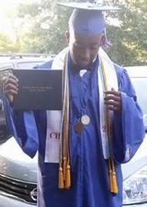
Project BC
Koran Wright
Sophomore
Computer Science & Mathematics major
Mississippi Valley State University
DREU intern under Dr. Gilbert

Slide 2
Summer Research
This summer at University of Florida, I learned about the project Prime III.
Prime III being a software for people with disabilities and speak different languages to vote.
The project I was given, along with two other DREU students, was to create a website that allows people to create a ballot for the prime III software.

Slide 3
Summer Research
The project required knowing what comes with creating a ballot, different ways to designing a website, and gathering enough information from users.
The project would require trail and error to better the project as much as possible.

Slide 4
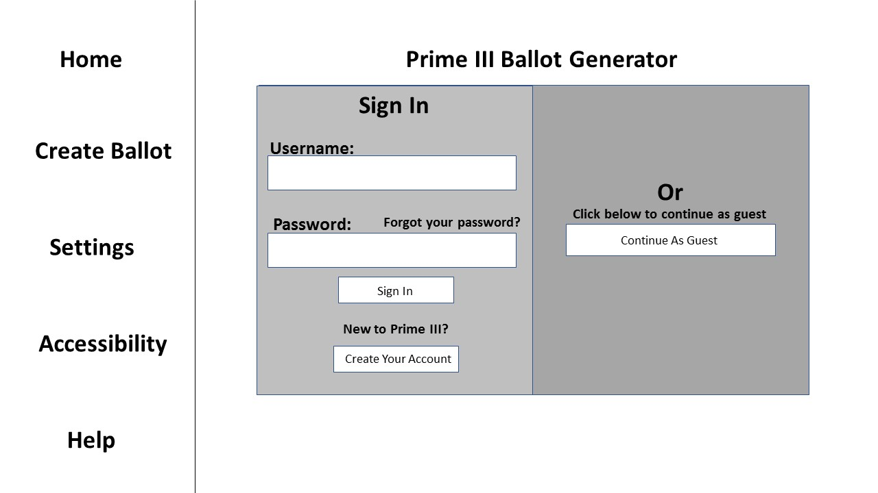
Project Ballot Creator Pics

Slide 5
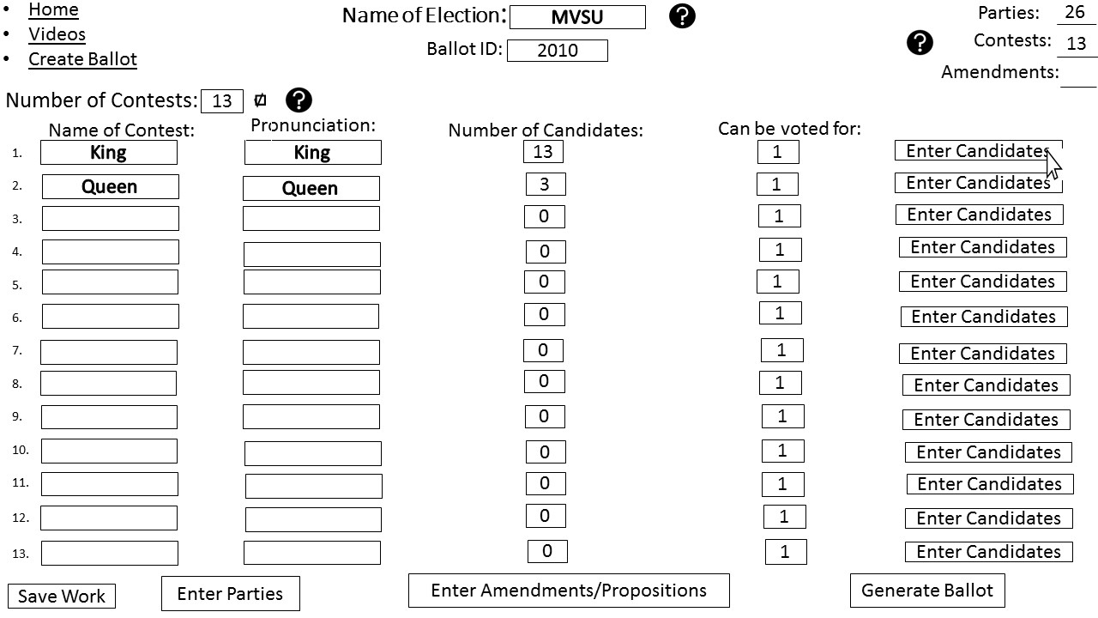
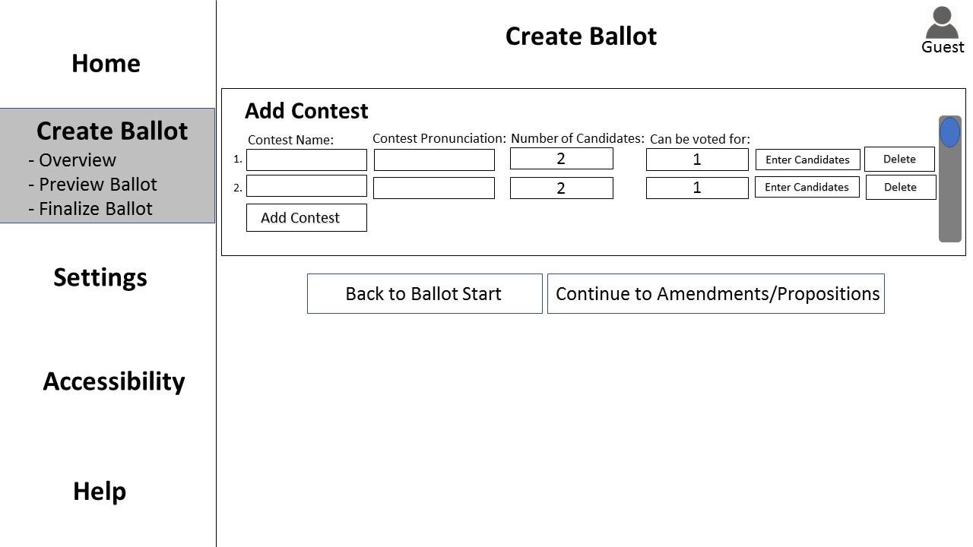
Wire Frames

Slide 6
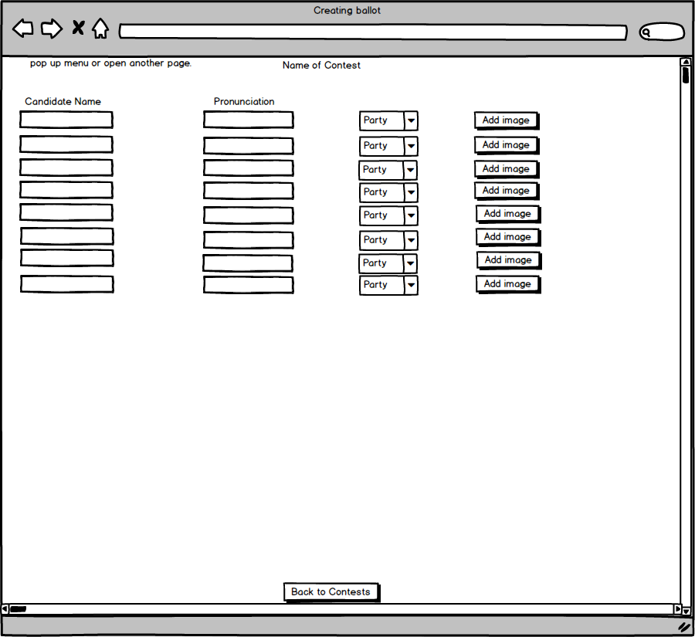
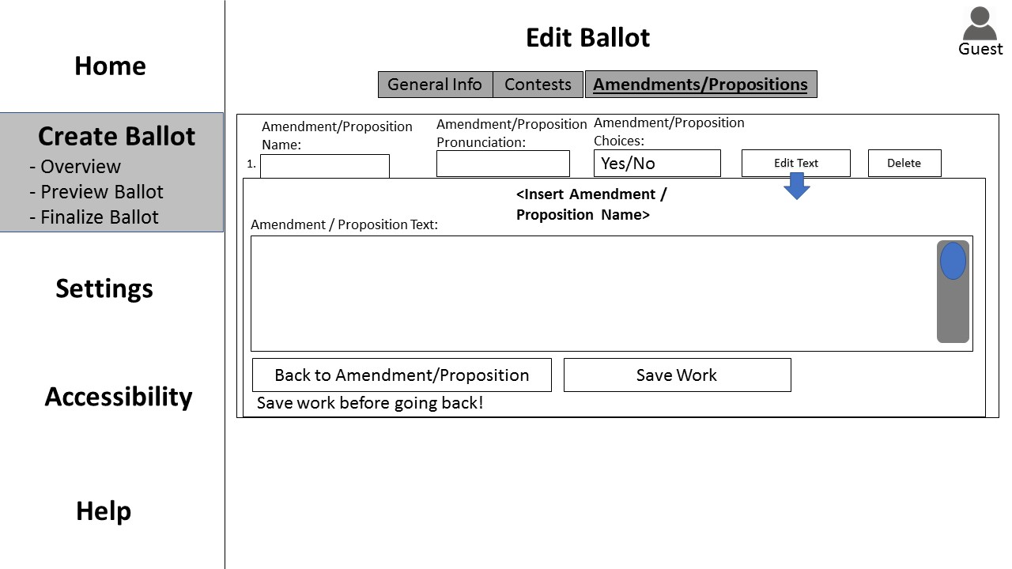
Wire Frames

Slide 7
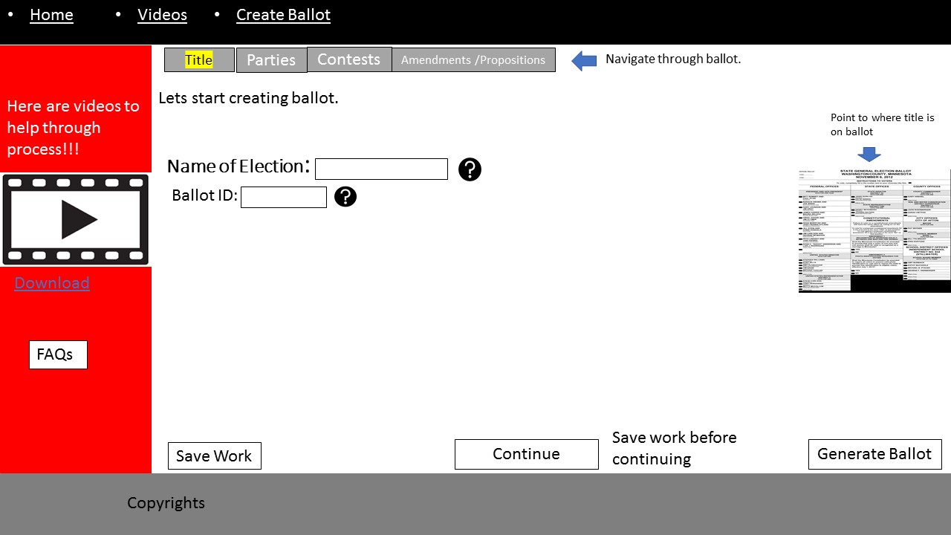
Wire Frame

Slide 8
Outlook
This summer has been a great first experience at an internship for me.
I want to thank DREU, Dr. Juan E Gilbert, the Grad students, and other DREUs for making this summer one of the best time I have had and making this possible for me.
The objective to learn something from this summer was a success. Once again thanks.

