Slide 1
LINGUISTIC
RESEARCH PRESENTATION
PHOEBE BURNS
Guorui Li, Yingzhi Yang, Sicheng Li, Robertson Bassy, Nandakrishnan Ramesh
Drs. Cheryl D. Seals, Marisha Speights, Dallin Bailey

Slide 2
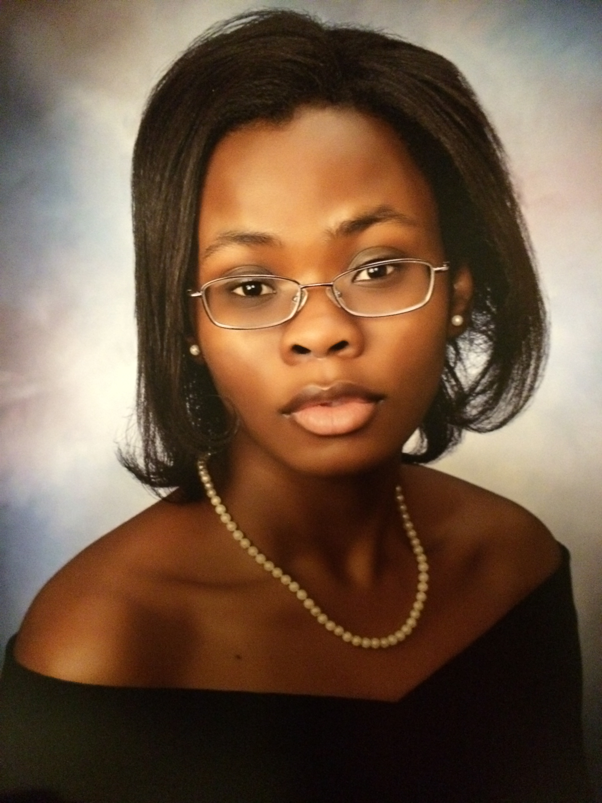
PROFILE
University of Alabama, Senior
B.S. Computer Science and B.F.A Digital Art
Future Plans
Paul Jones Program/Get a Job
Research
Making Logos
Learning Blender
Learning Maya

Slide 3
LINGUISTIC ARTICLES

Slide 4
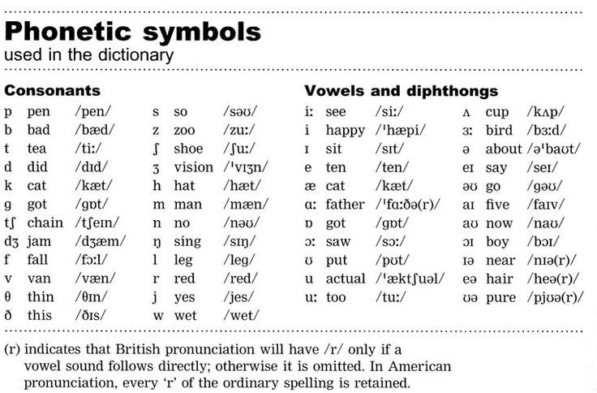
SPEECH TECHNOLOGY IN COMPUTER-AIDED LANGUAGE LEARNING: STRENGTHS AND LIMITATIONS OF A NEW CALL PARADIGM
Speech Technology in Computer-Aided Language Learning(CALL): Strengths and Limitations of a New Call Paradigm
Farzad Ehsani and Eva Knodt
Proposes using Automatic Speech Recognition (ASR)
Computer needs to understand phonological, lexical, semantic, grammatical, and pragmatic conventions of language
Computer Digits
HMM Approach was the most effective at this time
Problem: When trained to hear a certain accent, it performed poorly in understanding others.

Slide 5
HMM SPEECH RECOGNITION APPROACH
Hidden Markov Modeling
Signal Analysis
Purpose: Analyzes incoming audio and match against the pre existing model
Phone Models
Purpose: Trains the model to recognize speech and helps form words and sentences
Con: Performs poorly when heavy accents are spoken
Lexicon
Dictionary of trained language
Con:
Too Large-increased misrecognition
Too Small-increased out of vocabulary errors
Language Model
Predicts word association
Decoder
Matching speech with database homophones

Slide 6
A BLENDED-LEARNING PEDAGOGICAL MODEL FOR TEACHING AND LEARNING EFL SUCESSFULLY THROUGH AN ONLINE INTERACTIVE MULTIMEDIA ENVIROMENT
A Blended-Learning Pedagogical Model For Teaching and LEARNING EFL SUCESSFULLY THROUGH AN ONLINE INTERACTIVE MULTIMEDIA ENVIROMENT
Emerita Banados
Before Paper was written, Chileans who took 600 hours of learning English were still not proficient in the Language
Blended Learning of Face to Face and Online
Survey of students preferred Face to Face
Online makes them feel isolated
Incorporates integration of American and Chilean mentors
Cultural differences and similarities expressed
CALL (Computer Aided Language Learning)
Students taught with visual, aural, and written
Encouraged to watch or listen to English on the TV and Radio

Slide 7
DESIGN ARTICLES

Slide 8
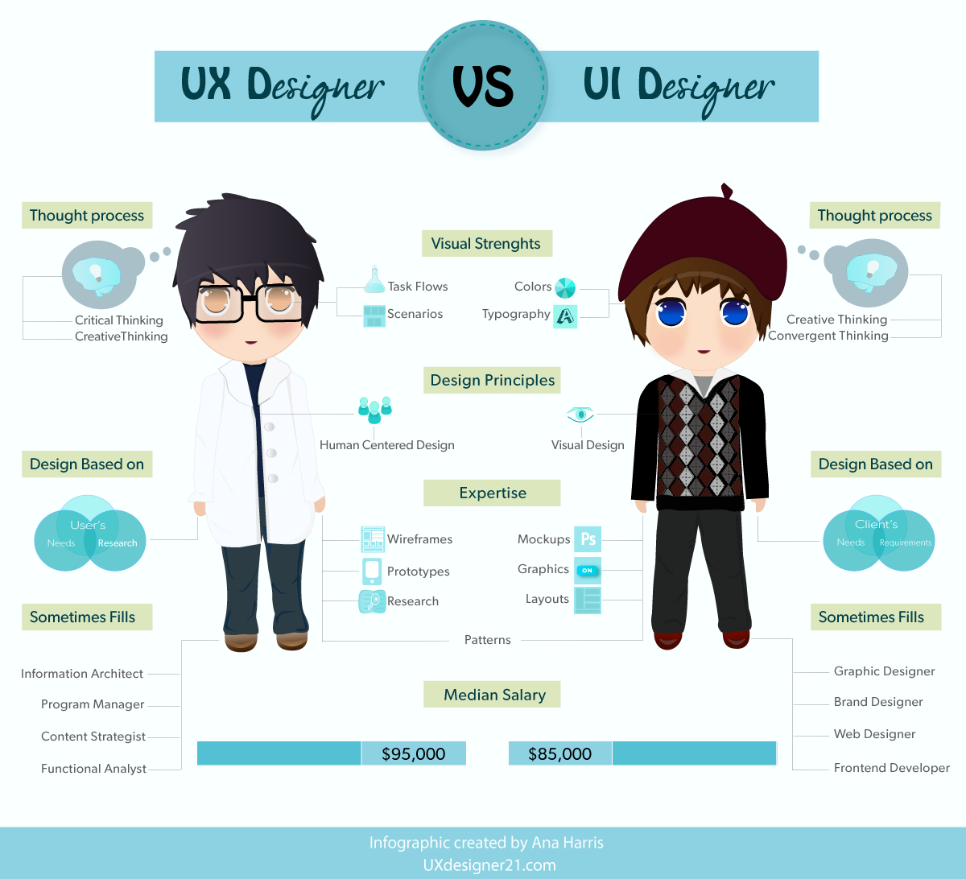
THE 6 TRUTHS ABOUT UX DESIGN
UI vs UX
User Experience is more than just Designing the User Interface
Usability
Personalization
Simplicity
What the User wants
NOT what the designer wants
Good UX=More Money

Slide 9
ALT COMMUNICATIONS

Slide 10
A website for the Linguistics classes
Special: Able to read IPA keyboard from user
Keyboard Levels
Requires a special algorithm to grade tests
Roles
Example Test Page
Linguistics
Research

Slide 11
DESIGN TEMPLATES

Slide 12
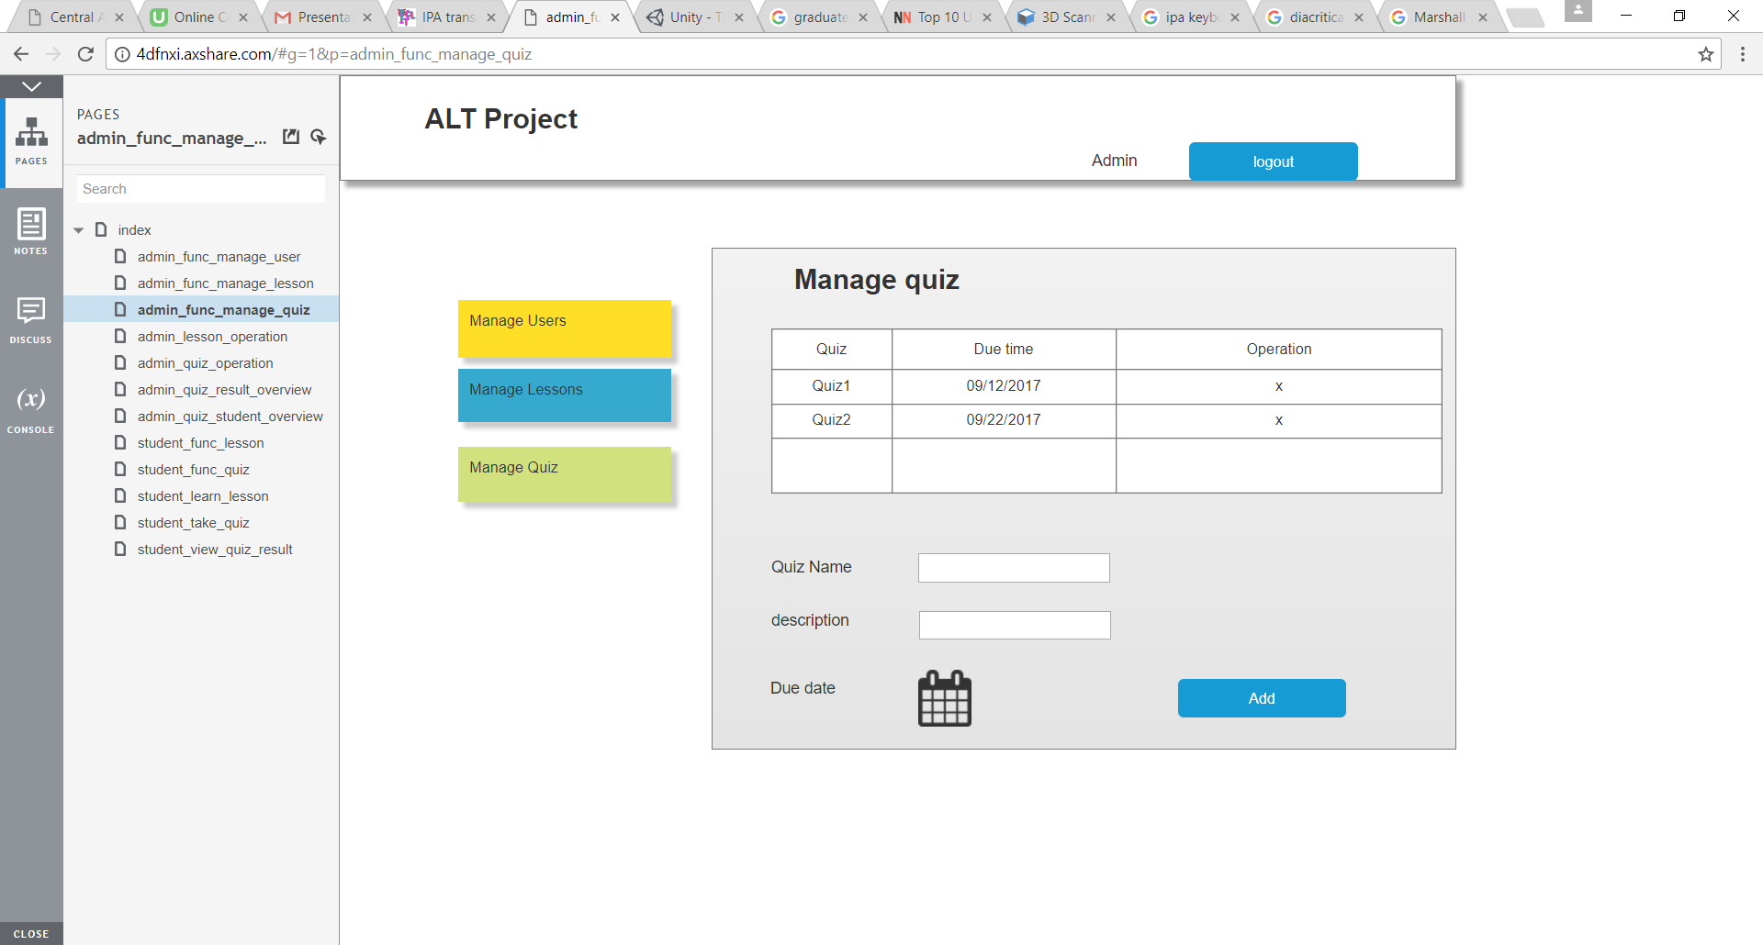
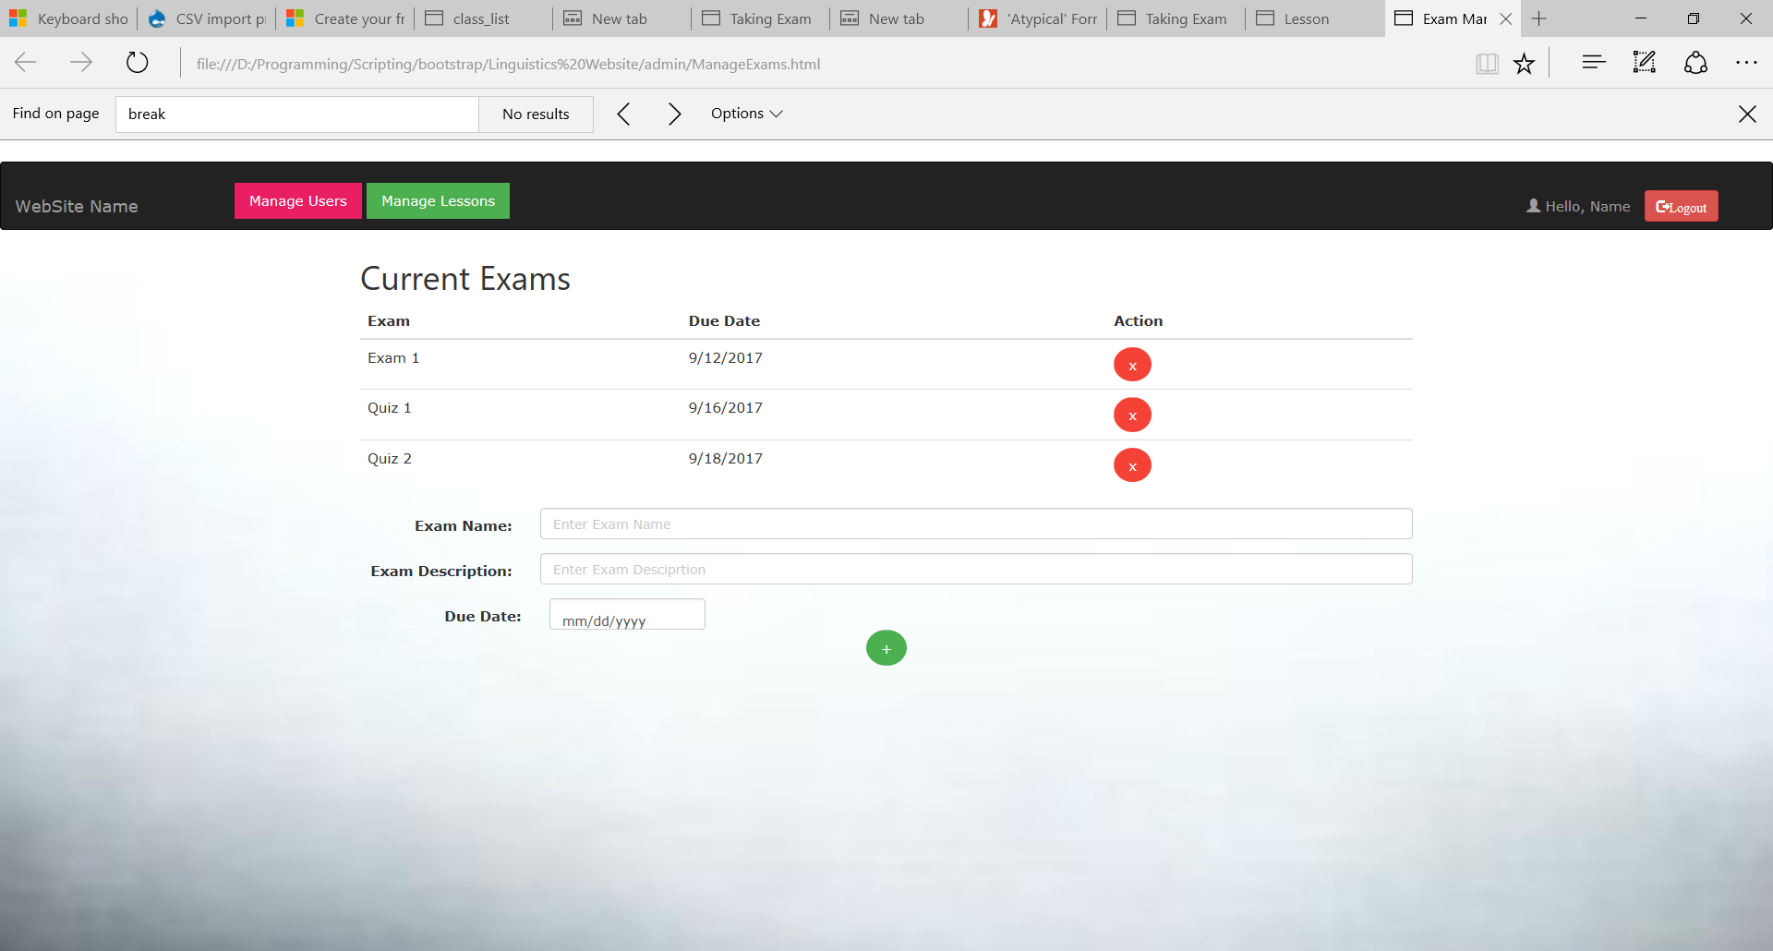
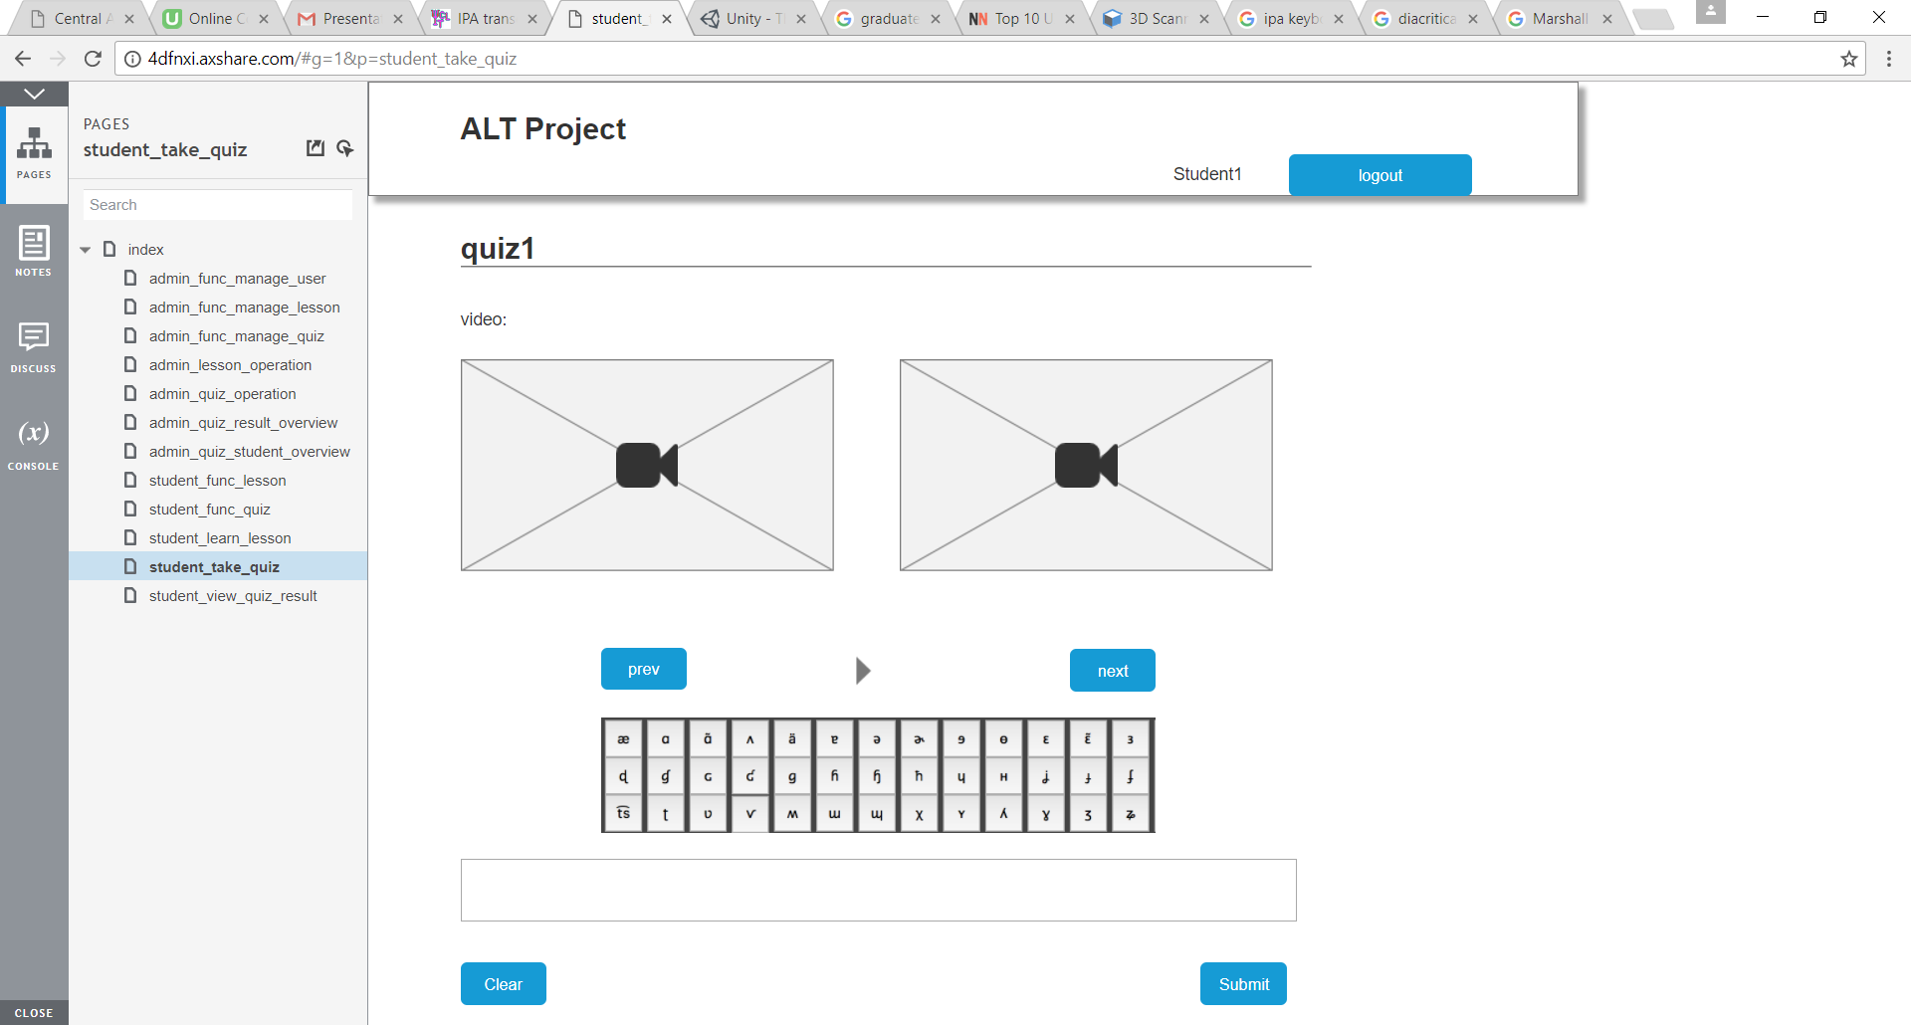
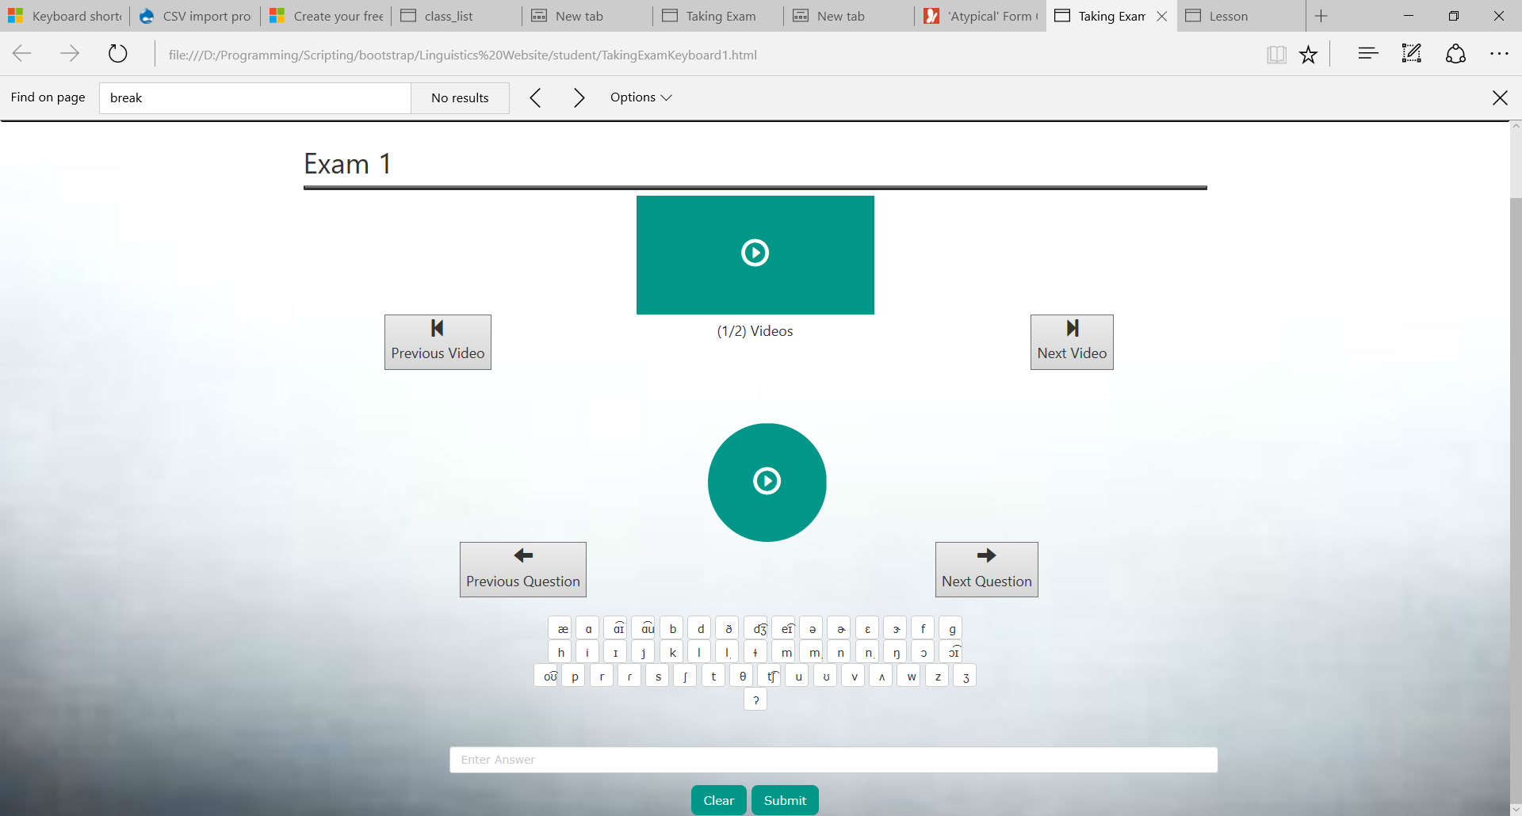

Slide 13
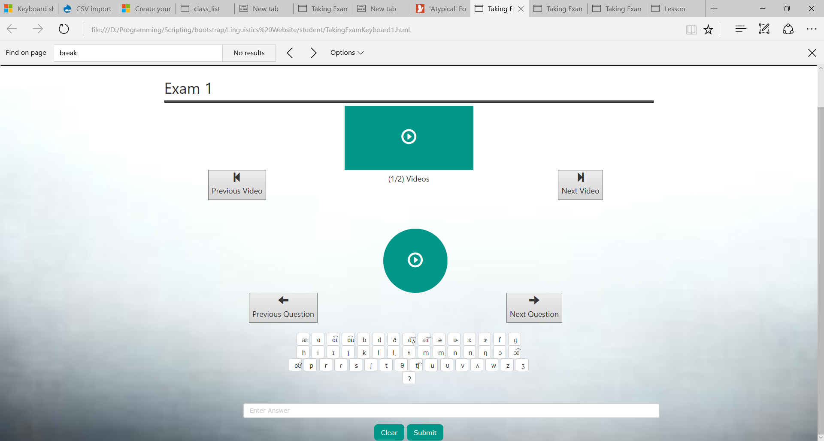

Slide 14
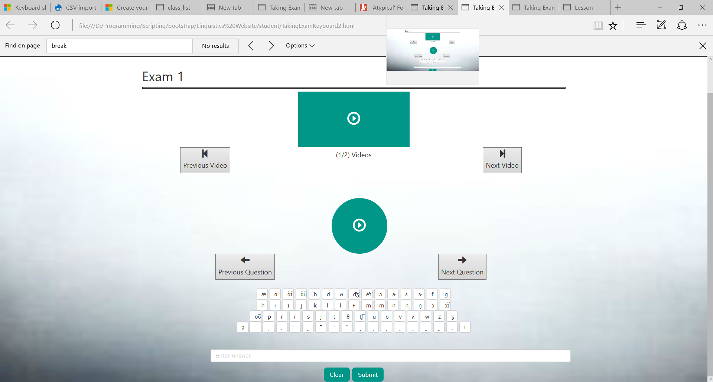

Slide 15
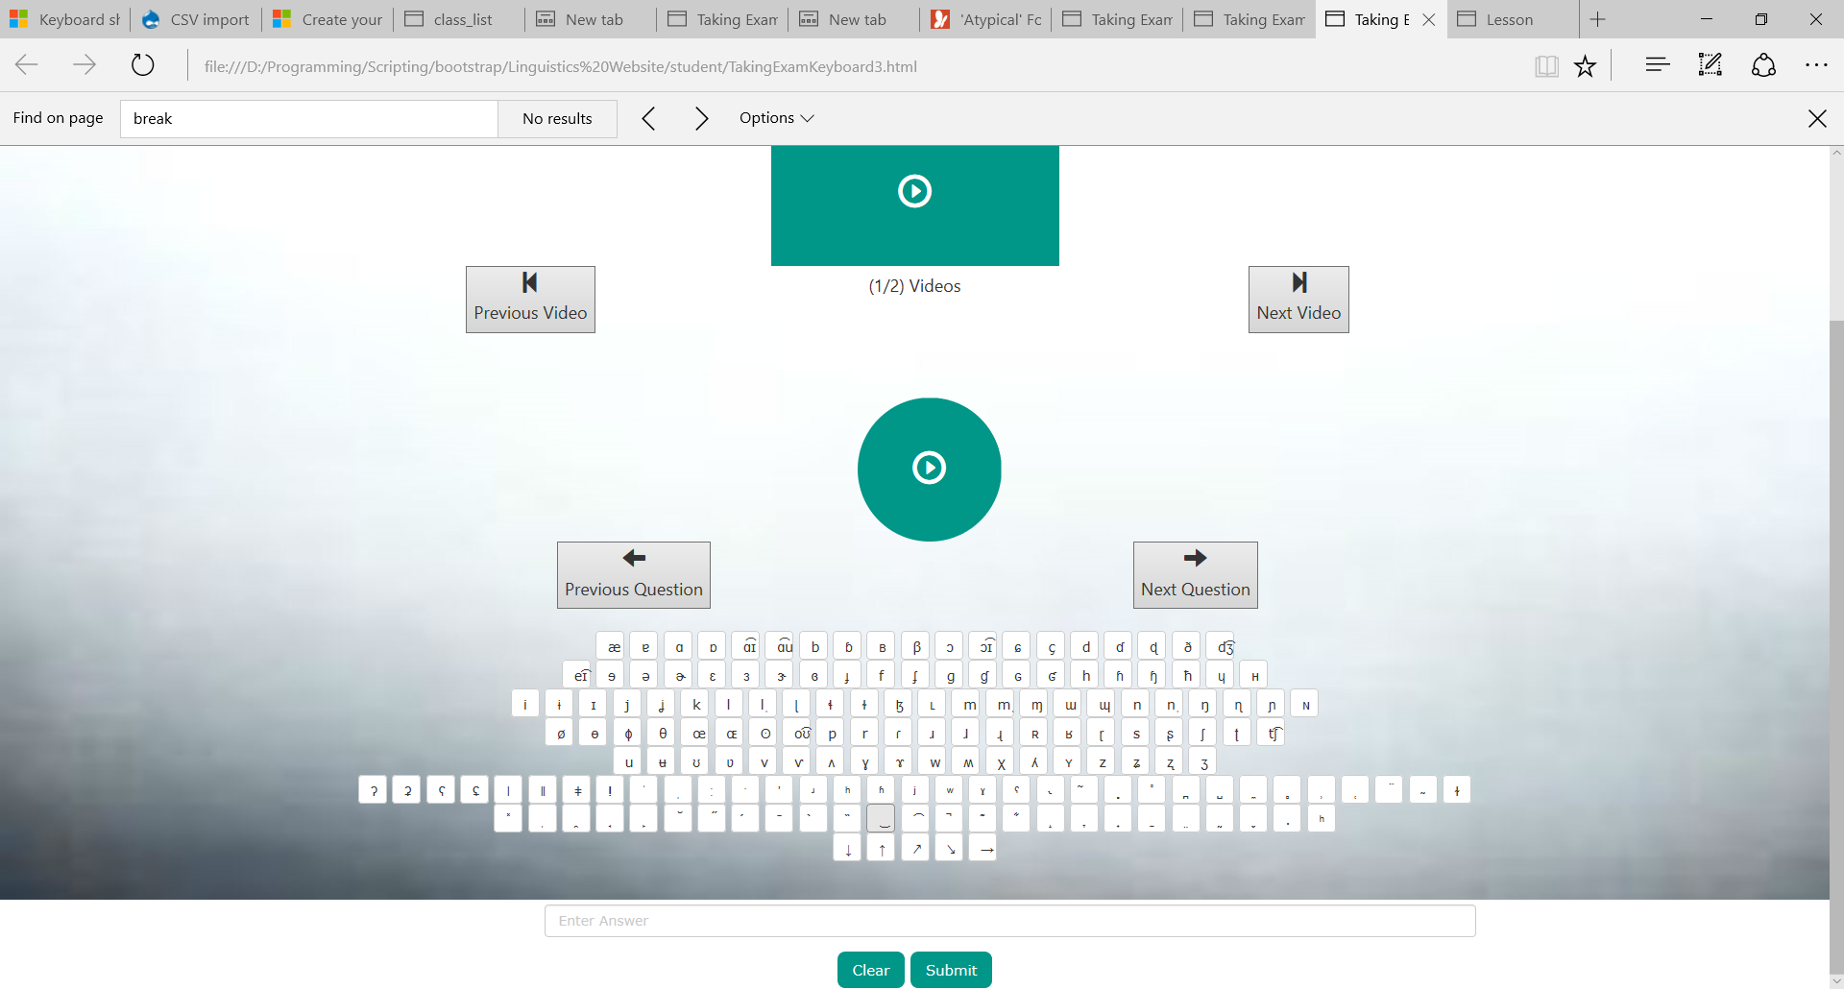

Slide 16
INTEGRATION
DEMONSTRATED BY SICHENG LI

Slide 17
Algorithm
DEMONSTRATED BY YINGZHI YANG

Slide 18
References
Farzad Ehsani, and Eva Knodt. "SPEECH TECHNOLOGY IN COMPUTER-AIDED LANGUAGE LEARNING: STRENGTHS AND LIMITATIONS OF A NEW CALL PARADIGM." (1998): 1-19. Web. <http://llt.msu.edu/vol2num1/article3/>.

