Slide 1
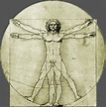
ERGOeasy
Human Computer Interaction (Hci) CSSE/ISE department
Gwendolyn Tennell
Jesse Gamez
Dr. Cheryl Seals
From paper to online/handheld
Saturday July 11, 2015
Notes:
Hello my name is Gwendolyn Tennell and the name of my project is ERGOeasy.

Slide 2
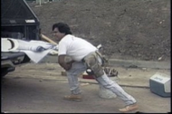
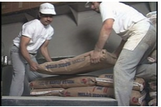
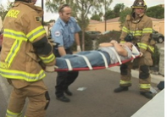
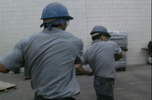
Hazards in the workplace
Notes:
One of the Grand challenges today is health informatics. A major problem in a workplace is that employees run the risk of getting hurt or being seriously injured. According to the us depart of labor there is an estimated $1 billion dollars per week for worker’s compensation cost. Human Factor Specialist or Ergonomics are professionals that companies use to assess risk in the workplace. As you can see per the pictures, different movements can create different injuries. Our goal is to improve the way an ergo specialist assess risk. Instead of the current way that the specialist take notes and goes back to the office to assess the risk..we have designed a program which can be used on a handheld device, in order for the ergo specialist to make immediate changes. This can readily reduce injuries and corporate losses.

Slide 3
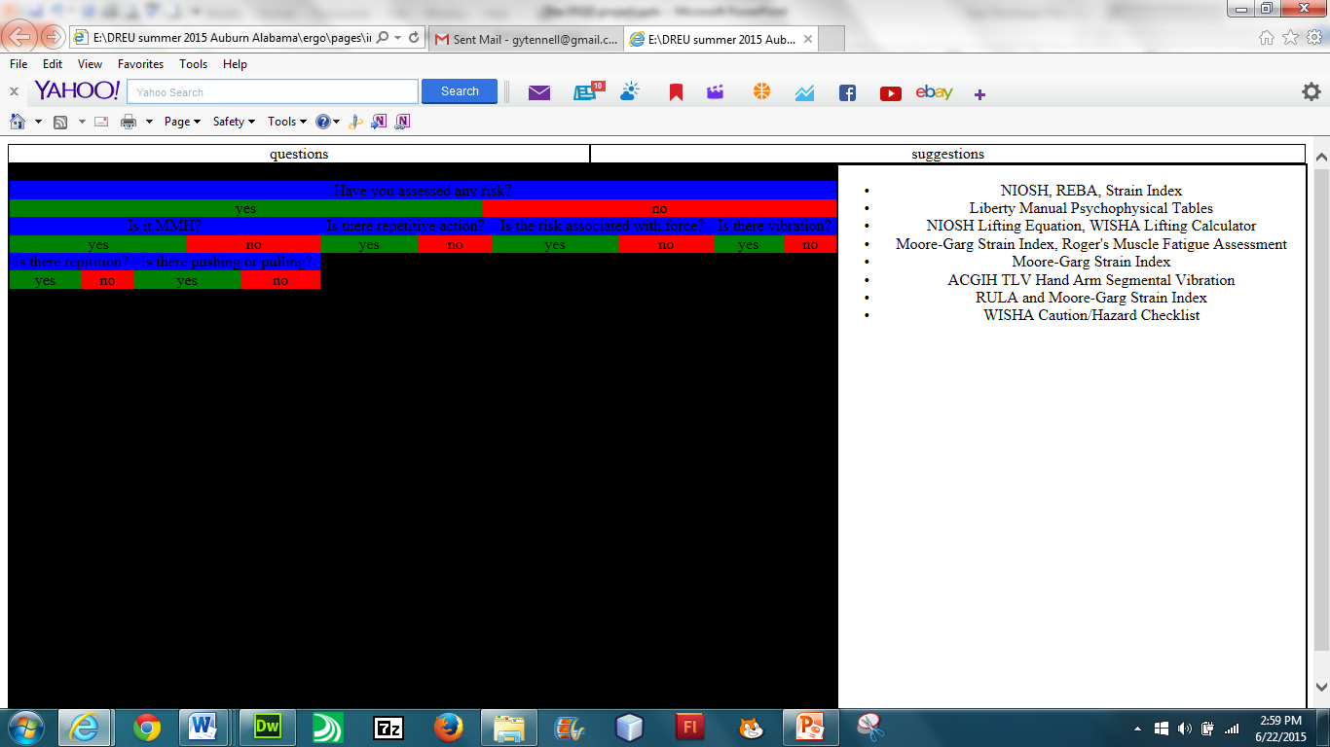
Wireframe
Notes:
This is the initial wireframe for our program.

Slide 4
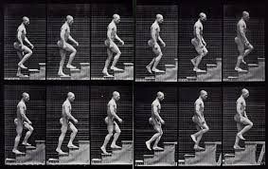
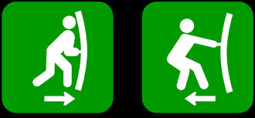
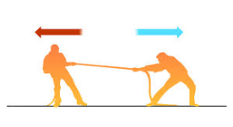
CONCEPTUAL DESIGN
WISHA Caution/Hazard Checklist
WISHA Caution/Hazard Checklist
NIOSH, REBA, Strain
Moore-Garg Strain Index, Roger's Muscle Fatigue Assessment
Liberty Manual Psychophysical Tables
NIOSH Lifting Equation, WISHA Lifting Calculator
Moore-Garg Strain Index
ACGIH TLV Hand Arm Segmental Vibration
RULA and Moore-Garg Strain Index
UET
MMH
Never assessed a risk?
SUGGESTIONS
NIOSH, REBA, Strain Index
Liberty Manual Psychophysical Tables
NIOSH Lifting Equation, WISHA Lifting Calculator
Moore-Garg Strain Index, Roger's Muscle Fatigue Assessment
Moore-Garg Strain Index
ACGIH TLV Hand Arm Segmental Vibration
RULA and Moore-Garg Strain Index
repetitive action?
repetitive action?
pushing or pulling?
force?
NEITHER
vibration?
NEITHER
Notes:
This is one of the Conceptual designs that I am working on. When entering the program there are 4 options.
First one is the UET, when chosen leads to questions that will assist in choosing which tools you need for different action such as…
The next one is MMH..which also leads to questions and eventually the right tool.
If never assessed a risk..you would choose the next button, which will give the WISHA checklist to help you.
And for the more experienced specialist…the suggestion button will list all tools, so if you know which one you need you can go right to it.
Our implementation is written in javascript and html. Thank you are there any questions.

