Slide 1
Leveraging Robotic Simulation in Design for Space Applications
Kylan Race

Slide 2
Introduction
How much help can simulations provide?
What is being covered:
Why simulate?
The process
The tests
What did I learn from the tests?
Difficulties
The future

Slide 3
Why Use a Simulation?
“Downsides” to physical robots:
Requires “a lot” of man power
Very dependent on physical resources
Number of robots very limited
Difficulties in transporting hardware

Slide 4
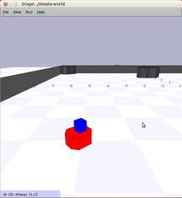
The Process
The Stage Simulator
Before Constructing Environments:
(2 Days)
Number of environments needed
Differences between the various tests
What I wanted to finish before the summer was over
(3 Days)
The Look
Outliers

Slide 5
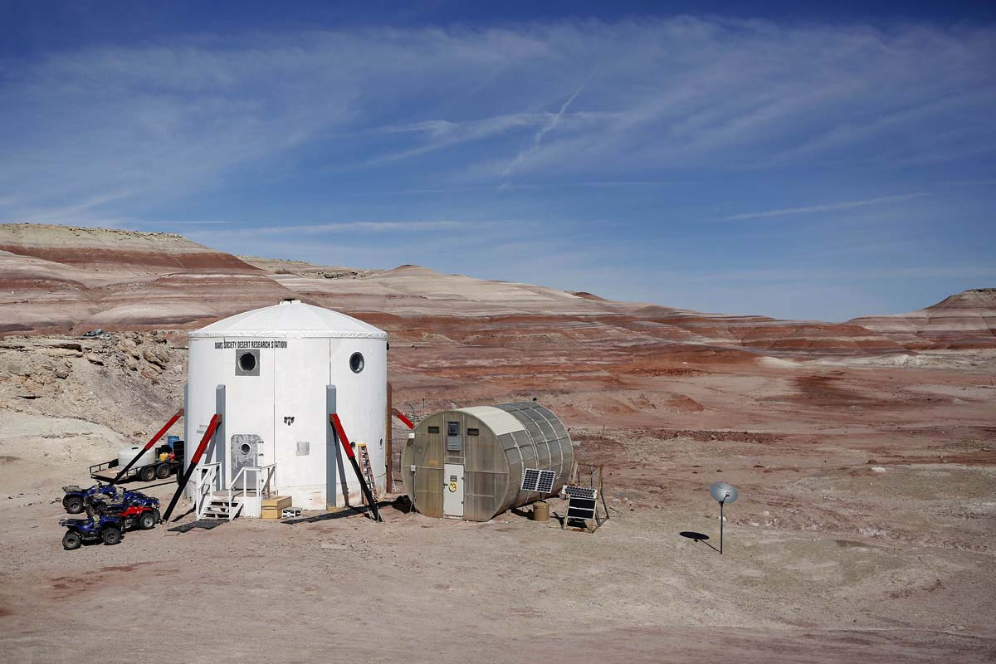
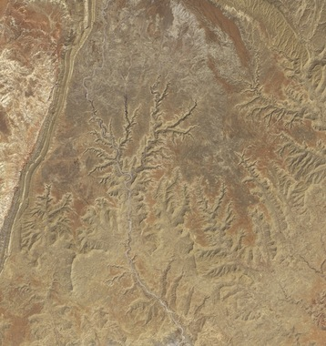
The Process cont. – The Look
Simulation of a simulation
MDRS
Reference Sources
Topography Maps
Research Galleries
Question Session

Slide 6
The Process cont. - Outliers
Removing Outliers
Skew results
Edit, don’t create
Saves time
List of 47 questions
Reduced to 9

Slide 7
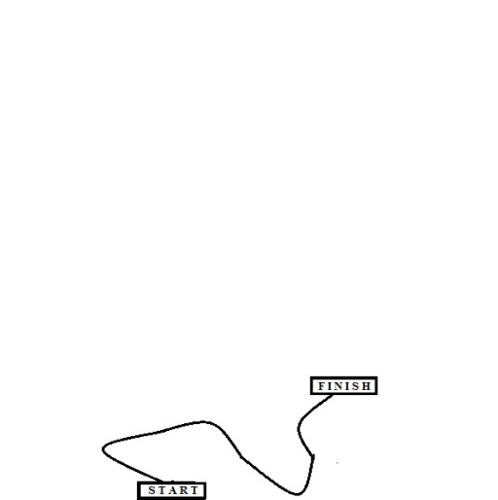
The Process cont. – Building Worlds
World files (16)
Python Code
Image File (33)
Tools
Paint / Gimp / Photoshop
Text Editor (vi / gedit)

Slide 8
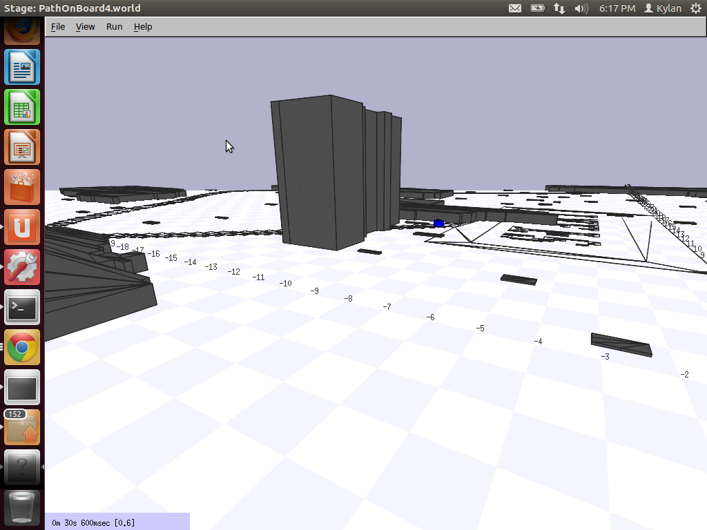

Slide 9
The Process cont. - Controls
Directional Key Control
Always updating controls
Scaling speed
Switch to browser

Slide 10
The Tests
In Beginning:
4 POVs
3 Tasks
4 Visual conditions
Removed POVs
Support Vehicle vs. EVA
Third Person Camera
Final POVs
EVA
Onboard Camera

Slide 11
The Tests cont. – Visual Conditions & Pre/Post-Test
Constraints:
None
Boulders
A Wall
Boulders and a Wall (Most difficult)
Pre-Test:
15 minute deadline
Instructional prompt
Questions regarding background
Post-Tests:
Test difficulty

Slide 12
What did I learn from the tests?
What method was best?
Efficiency
Hypotheses:
Highest Efficiency: Onboard POV (True)
Resolution, FOV
Singular task (controlling the robot)
Perceived Aptitude =/= Results (True)
“Experts” did poorly
“Inexperienced” did well

Slide 13
Difficulties
“Small”
405 errors
Over reactive controls
Corrupted / Out of date files
“Biggest”
Virtual Box 4gb
Still not solved

Slide 14
The Future
More into the cloud
Simulations being used remotely
Deeper into Stage

Slide 15
Acknowledgments
Professor Sekou Remy
Jerome McClendon
DREU Fam

