Slide 1
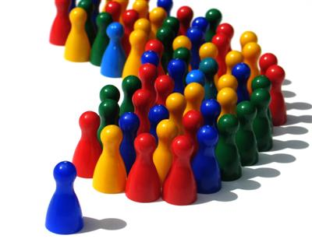
An Investigation of Facebook Grouping
facebook Home Profile Account
Search
Robin Brewer
Yael Mayer
Lorrie Cranor
Patrick Kelley

Slide 2
facebook Home Profile Account
Search
Outline
Introduction
Related Work
Methodology
Observations
Future Steps

Slide 3
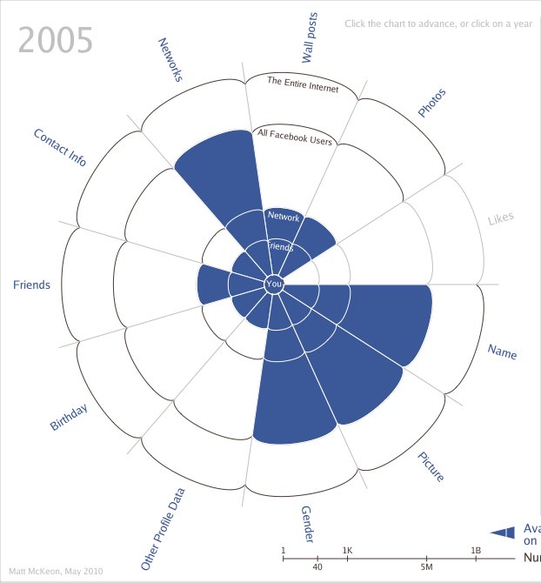
introduction related work methodology observations future steps
Facebook’s privacy settings have changed over the years.
Each time making more information public by default.
Notes:
Over 500 million users

Slide 4
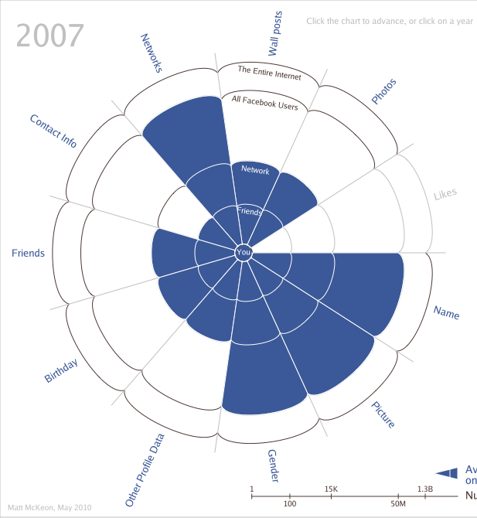
introduction related work methodology observations future steps
Facebook’s privacy settings have changed over the years.
Each time making more information public by default.

Slide 5
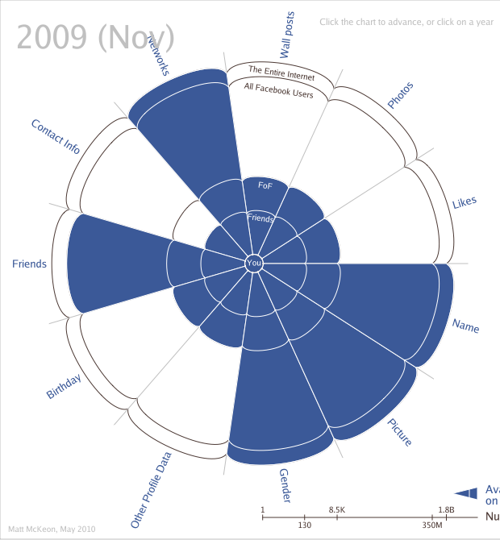
introduction related work methodology observations future steps
Facebook’s privacy settings have changed over the years.
Each time making more information public by default.

Slide 6
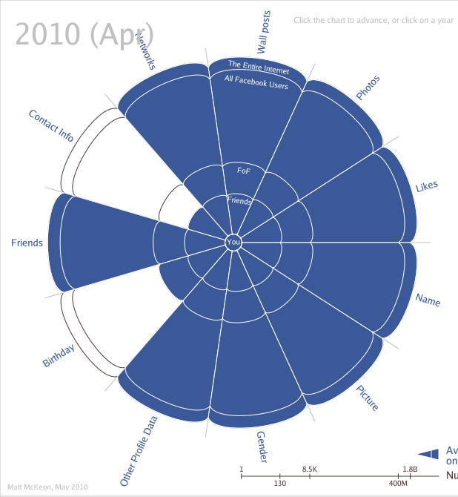
introduction related work methodology observations future steps
Facebook’s privacy settings have changed over the years.
Each time making more information public by default.

Slide 7
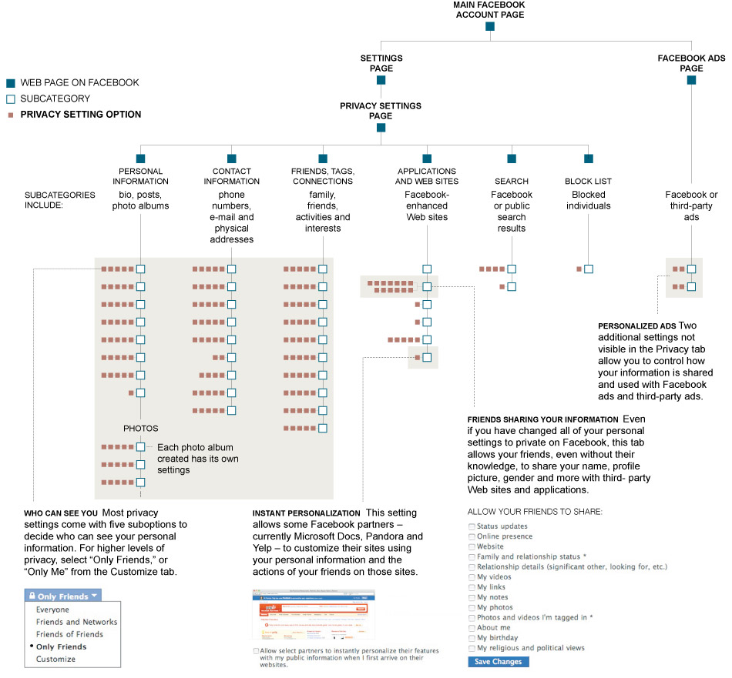
introduction related work methodology observations future steps
Changing the settings requires navigation through many levels of Facebook pages
April 2010
The New York Times
Notes:
Explain chart

Slide 8
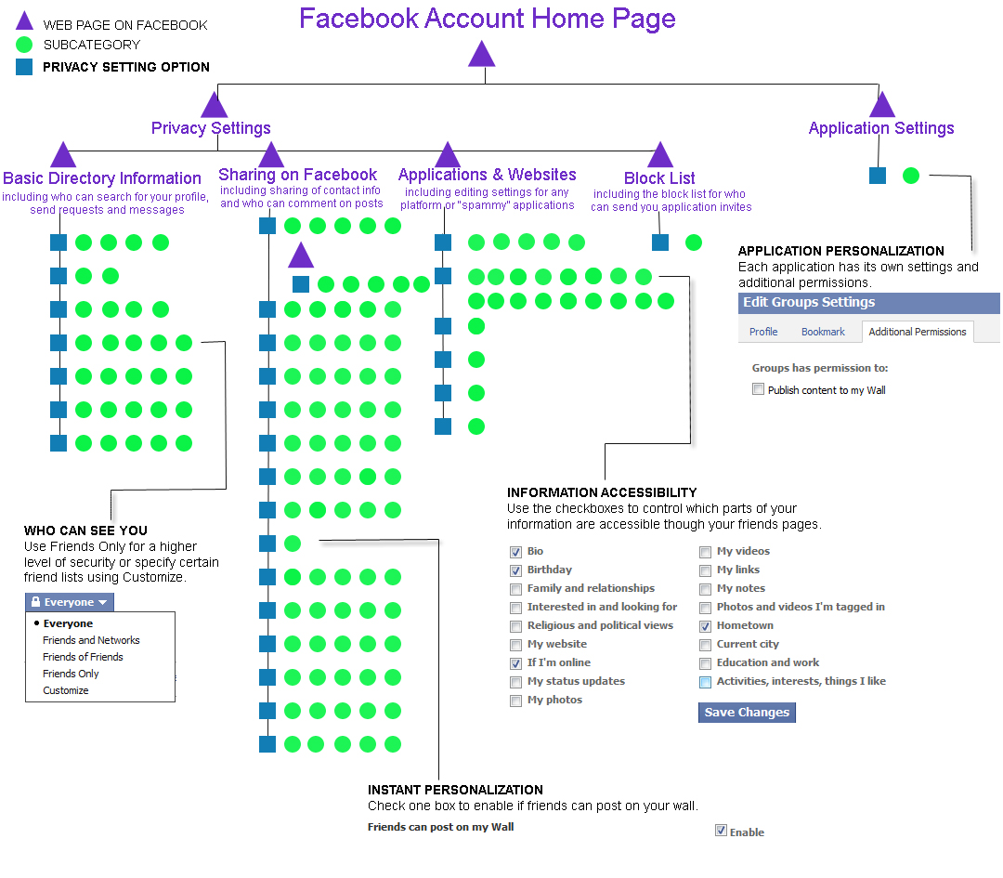
introduction related work methodology observations future steps
June 2010
Robin Brewer

Slide 9
introduction related work methodology observations future steps
The difference? Less privacy controls
Still confusing
The “Friends Only” option may not be enough
Our solution? Make it easier
for people to edit their privacy
settings…
Notes:
“Friends only” is the most stringent privacy setting besides “only me”
People may want to share different things with different Friends

Slide 10
introduction related work methodology observations future steps
The difference? Less privacy controls
Still confusing
The “Friends Only” option may not be enough.
Our solution? Make it easier
for people to edit their privacy
settings…
by making it easier for people to make groups

Slide 11


introduction related work methodology observations future steps
Goals
Gather information about people’s thought process when grouping Facebook friends
Create interface for Facebook friend lists
Make it easier for people to control their privacy settings on Facebook

Slide 12
introduction related work methodology observations future steps
Goals
Gather information about people’s thought process when grouping Facebook friends
Create interface for Facebook friend lists
Make it easier for people to control their privacy settings on Facebook

Slide 13
introduction related work methodology observations future steps
Why Group-Based Privacy?
“The diversity of a network predicts online tension as a consequence of visible communication across social spheres” [Binder, Howes, Sutcliffe 2009]
People manage group co-presence by “using suitable channels of communication”, “self-censorship”, “trust” and “being responsible” [Lampinen, Tamminen, Oulasvira 2009]
In a small (10 participant) thesis study, nobody used friend lists to prevent online tension [Smart 2009]
Notes:
Facebook and other SNSs place people’s networks in one big bucket and calls them all ‘Friends’
Not representative of people’s real friends: meet different people in different contexts
May want to have different privacy settings for different groups of friends
Binder, Howes, Sutcliffe: methodology: surveyed 232 participants
Lampinen, Tamminen, Oulasvirta: 20 participants. online observations: by friending participants and following their public traces. semi-sructured interviews in which Facebook usage, groups and online tensions, privacy settings and issues were discussed. Considers groups and networks, but does not look at friend lists.
Smart: guided interviews and discussion through participants’ Facebook accounts.

Slide 14
introduction related work methodology observations future steps
Automated Approach to Grouping Friends
Work on developing an algorithm to group friends [Jones 2010]
15 participants to sorted their friends on xSort, card-sorting software
The groups participants made were used as a base truth to compare with the algorithmic groups
Algorithmic grouping is at best about 70% accurate compared to participants’ groups
Notes:
Research on automatic grouping
Downloaded participants’ entire networks and grouped them with a clustering algorithm

Slide 15
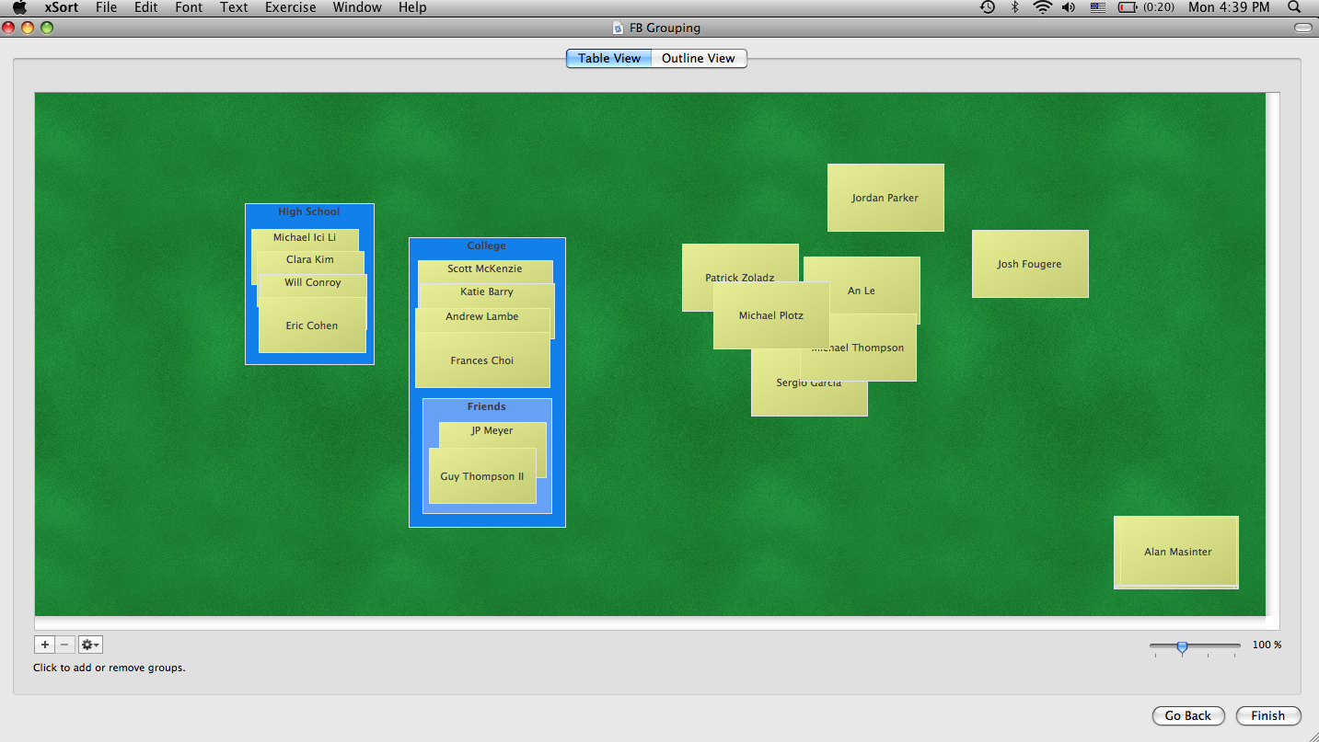
introduction related work methodology observations future steps
Limitations
Focus on algorithm, not groups
Largest Network examined: 312 Friends
xSort does not allow placing people in multiple groups
Do the groups participants make actually correspond to their sharing preferences?
Notes:
Limitations with Jones’ study with regards to what we’re interested in
This is a screenshot of xSort at work

Slide 16
introduction related work methodology observations future steps
Making Groups
We examined 4 different methods for people to group their friends in individual interviews:
    Card Sorting
    Grid Tagging
    Facebook Friend Lists Interface
    File Hierarchy
We do not want to prime subjects to group their friends in a certain manner
Notes:
Between-subjects study with 4 different methods
Did not want to prime subjects to group their friends in a certain manner

Slide 17
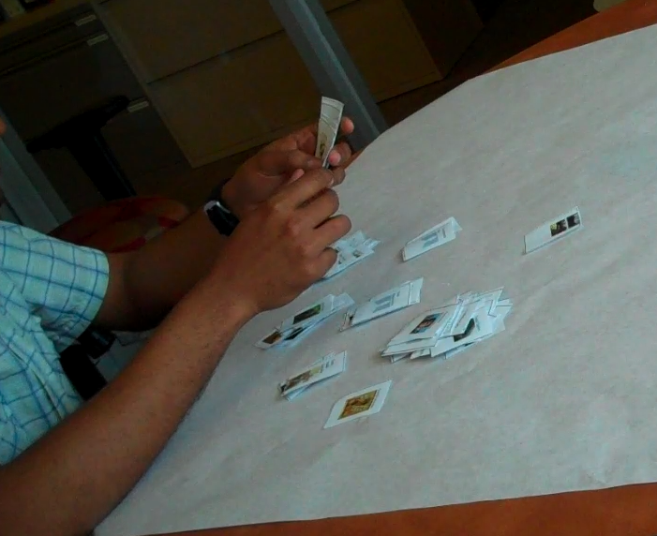
introduction related work methodology observations future steps
Card Sort

Slide 18
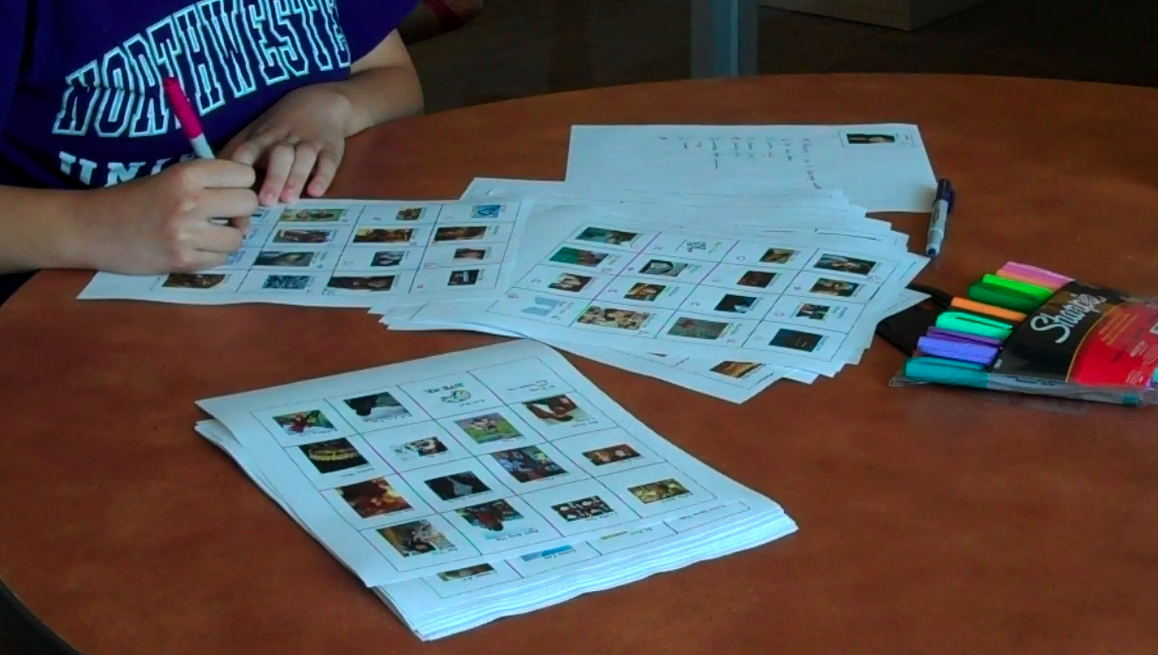
introduction related work methodology observations future steps
Grid Tagging

Slide 19
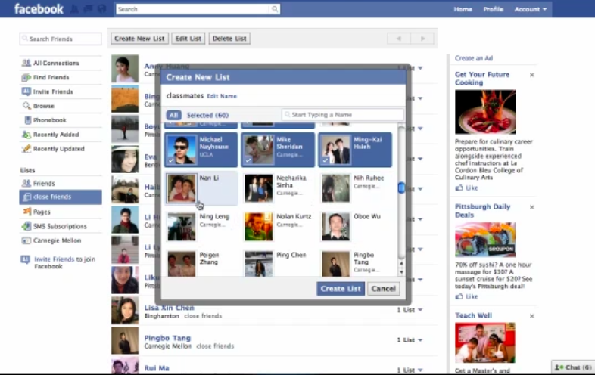
introduction related work methodology observations future steps
Facebook Friend Lists Interface

Slide 20
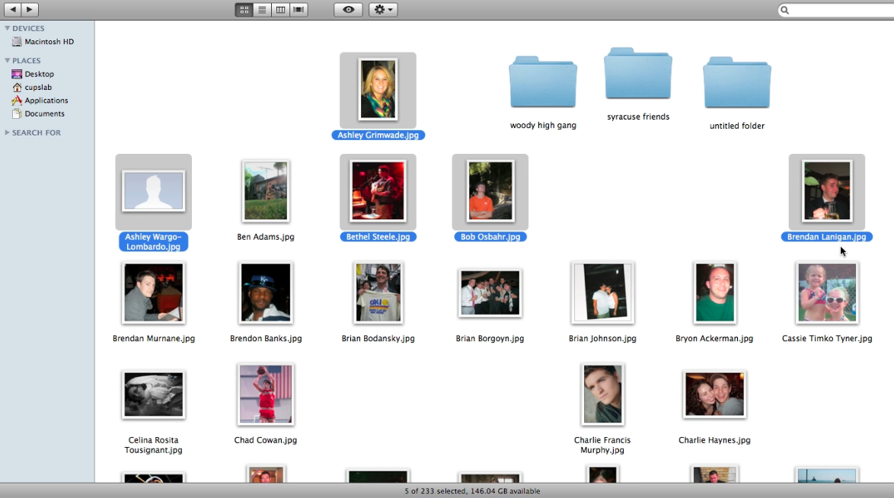
introduction related work methodology observations future steps
File Hierarchy

Slide 21
introduction related work methodology observations future steps
Free-form Individual Interviews
Participants categorized their friends into different groups
Participants were asked a series of privacy-related questions:
“Can you show us with who you would share your____ ?”
  Contact info
  Last vacation album
  Location
“Can you show us which of your friends you talk to the most on Facebook?”
“Can you show us who would you invite to a party at your home?”
Notes:
Interviewed each participant

Slide 22
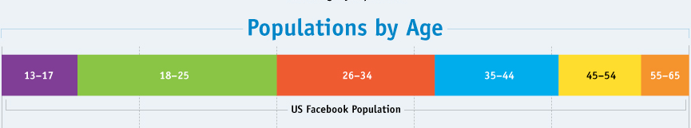
introduction related work methodology observations future steps
Demographics
No. of participants: 26
Infographic from Mashable: http://cdn.mashable.com/wp-content/uploads/2010/04/facebook-us-large.jpg
Notes:
Before getting to actual observations, here’s the demographics of 26 participants through last Friday
Mainly 18-25, not representative of Facebook’s typical age distribution
Will run more studies and advertise places other than cbdr

Slide 23
introduction related work methodology observations future steps
General ways to group friends
Method One: Group by Group
Make a group
Put all friends in that group
Create next group
Participant browses friends more
than once
Method Two: Friend by Friend
Look at a friend
Place friend in a group
Look at next friend
Participant browses friends only once
Notes:
One group at a time
One friend at a time
Grouping by method one and two overall shows no significance because data split down the middle

Slide 24
introduction related work methodology observations future steps
Grouping mechanism by sorting method
Group by group
Friend by friend
Notes:
Card sorting always 1 friend at a time because looking at a pile of friends and have to go through them all to group them.
FB Interface always 1 group at a time
W/grid and file hierarchy we see no pattern

Slide 25
introduction related work methodology observations future steps
Notes:
More friends = longer to group
Can’t compare specific methods to each other because don’t have FB and file hierarchy methods have not been tested w/participants more than 300 friends yet, but will happen as we continue to run more studies
Generally speaking, grid takes longer because have to flip through pages of their friends multiple times

Slide 26
introduction related work methodology observations future steps
Average of 7 groups
Notes:
Group #s between 3 and9
1 made 30 groups. 1 made 1 group
Average of 7 groups.

Slide 27
introduction related work methodology observations future steps
Notes:
Do people place friends in more than one group?
Cards – no
FB – some did on purpose; usually because you can’t see if you’ve already placed someone in a group when you go to create the next group

Slide 28
introduction related work methodology observations future steps
Current Usage of Friend Lists
30% of participants had Friend Lists in their accounts
Notes:
30 % had friend lists but 40% of them did not use them to control privacy settings
And most who had friend lists never updated them

Slide 29

introduction related work methodology observations future steps
Method-Specific Observations
“Can I do this?”
May not be apparent that they can place people into multiple groups
Pictures Please?
Card sorting – couldn’t recognize people with just a picture
Name and picture may not be enough, links needed
Mac vs. PC
File hierarchy problems because it’s a mac or it’s a computer?

Slide 30

introduction related work methodology observations future steps
Observations About the Groups
Common Tags : school/college, city, company/occupation, native country, where user met them
Common Group Names: college, high school, family,
close friends, others, people I don’t know
Dynamic vs. Static Groups
Groups change based on different scenarios
More Friends – Good or Bad?
“I could have been more accurate with less friends”
Less friends = more likely to look through all friends when re- grouping
Notes:
Before starting, we ran many pilot studies and saw that most people change their groups based on different scenarios.
From this we thought maybe a better interface could be one where people give tags to their friends to make it easier to make new groups based on the situation.
Asked participants what tags they would give to their friends and here are the most common names of tags
For the names of the actual groups that participants label themselves – the most common ones were:
Again saw ‘groups change’ but in 2 ways
Combine entire groups
Combine pieces of groups

Slide 31
introduction related work methodology observations future steps
Observations About Facebook and Privacy
The Public Assumption
“I assume everything is public once I put it on Facebook”
Profile Privacy Concerns
Parents, future employers
Farmville Addicts
Blocking applications vs. blocking people
Untag Me!
Unflattering or inappropriate
“This is not about privacy. They are just pictures.
I don’t think pictures are private”
Notes:
Asked if there were ppl who sent to many invites for applications – farmville and mafia wars addicts
And there were but most people would rather block the applications rather than block individual ppl from sending them
Also asked participants why they untagged themselves from photos – because …
Shows that different ppl consider different aspects of their profile privacy-related.

Slide 32
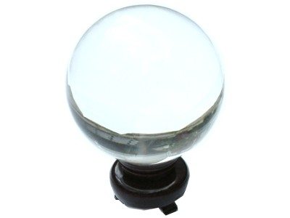
introduction related work methodology observations future steps
Future Steps
Observe more studies and see which method(s) are clearly better
  overlap good or bad?
Design and test an interface based on the best method(s)
Perhaps use as a secondary method to Simon Jones’ automated algorithm approach

Slide 33
facebook Home Profile Account
Search
Questions?

Slide 34
facebook Home Profile Account
Search
References
Binder, J., Howes, A., and Sutcliffe, A. (2009). Conflicting Social Spheres And Experienced Tension In Social Networking Sites. In CHI 2009 (Boston, MA, USA, April 4–9, 2009). ACM 978-1-60558-246-7/09/04.
Jones, S., and O’Neil, E. (2010). Feasibility of Structural Network Clustering for Group-Based Privacy Control in Social Networks. In Symposium on Usable Privacy and Security (SOUPS) July 14-16 2010, Redmond, WA, USA.
Lampinen, A., Tamminen, S., and Oulasvirta, A. (2009). All My People Right Here, Right Now: Management of Group co-Presence on a Social Networking Site. In Proceedings of the ACM 2009 international Conference on Supporting Group Work (Sanibel Island, Florida, USA, May 10-13, 2009). GROUP ‘09. ACM, New York, NY, 281-290.
Smart, D. (2009). How do people limit their behaviour in response to their perception of potential social tension? A study of Facebook. Manchester Business School Bsc. Interactive Systems Design.

