Slide 1
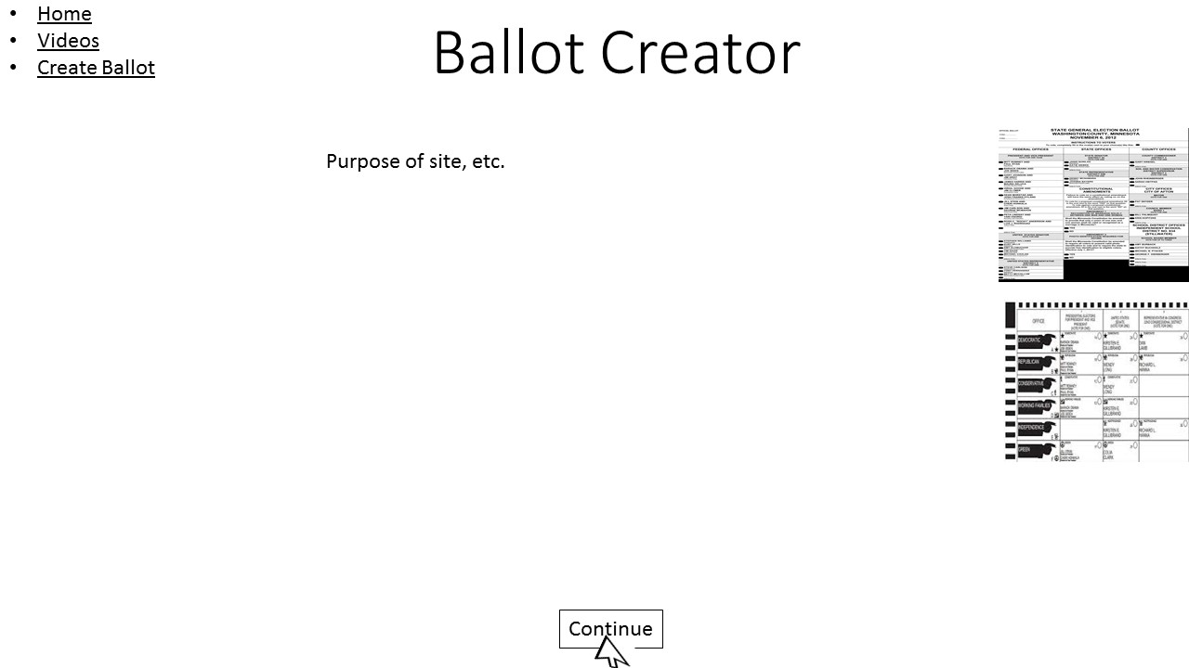
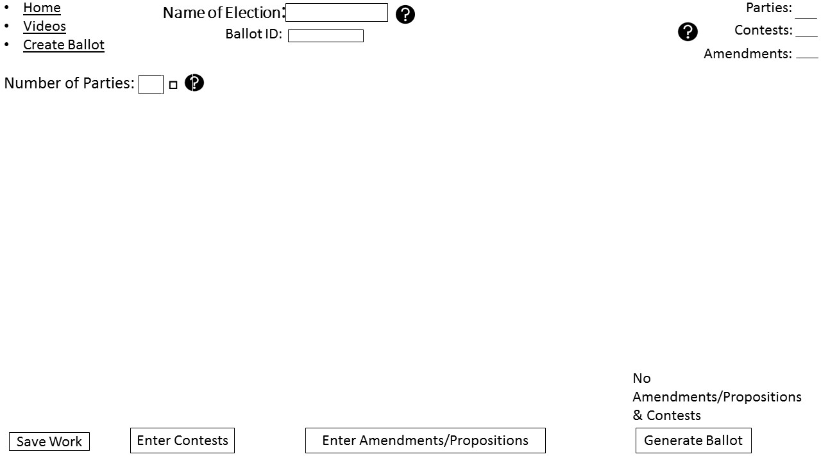
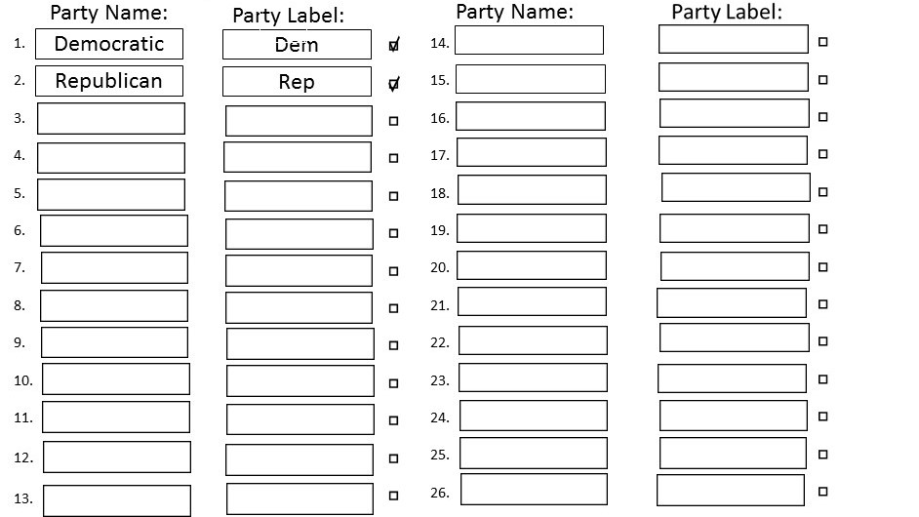
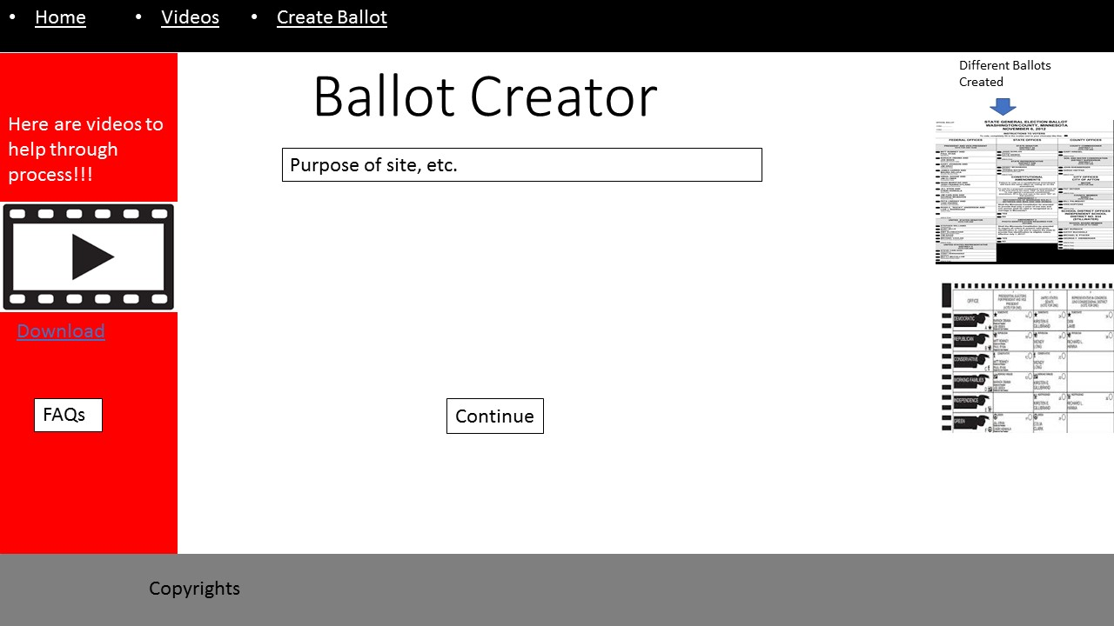
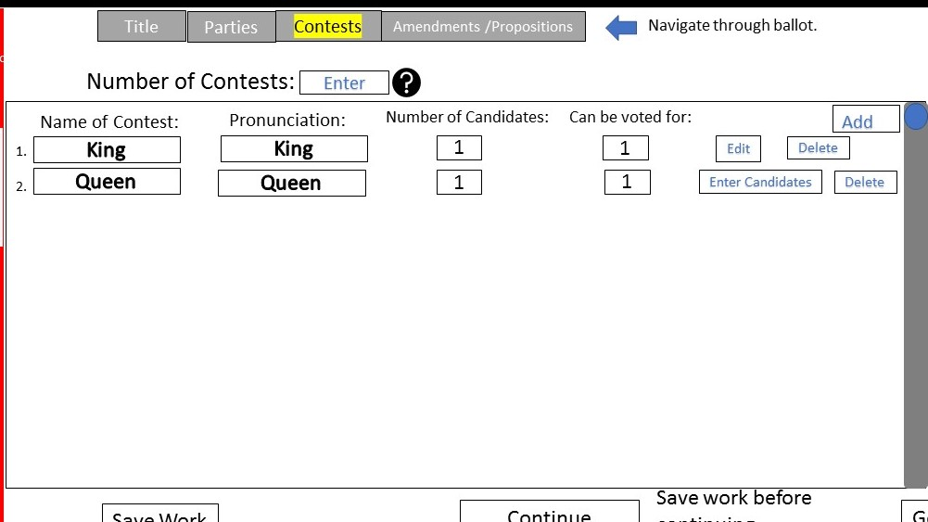
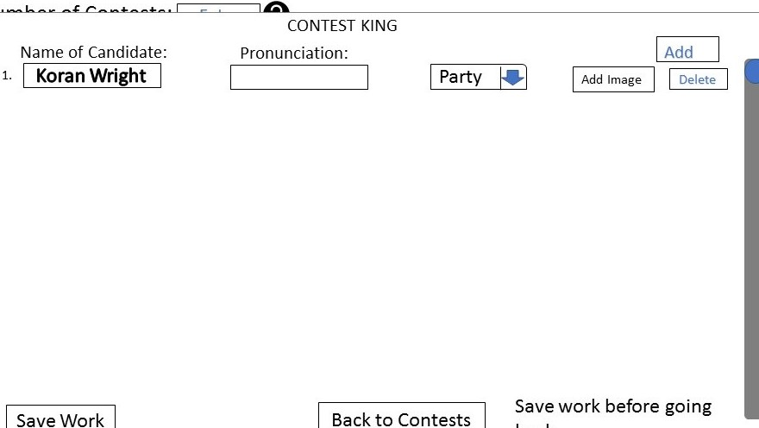
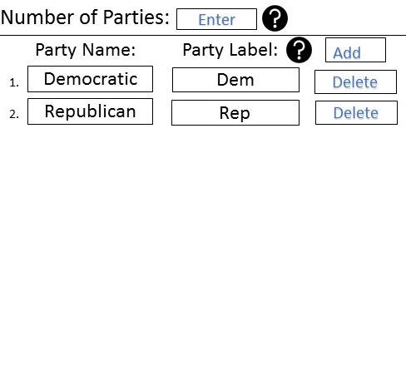
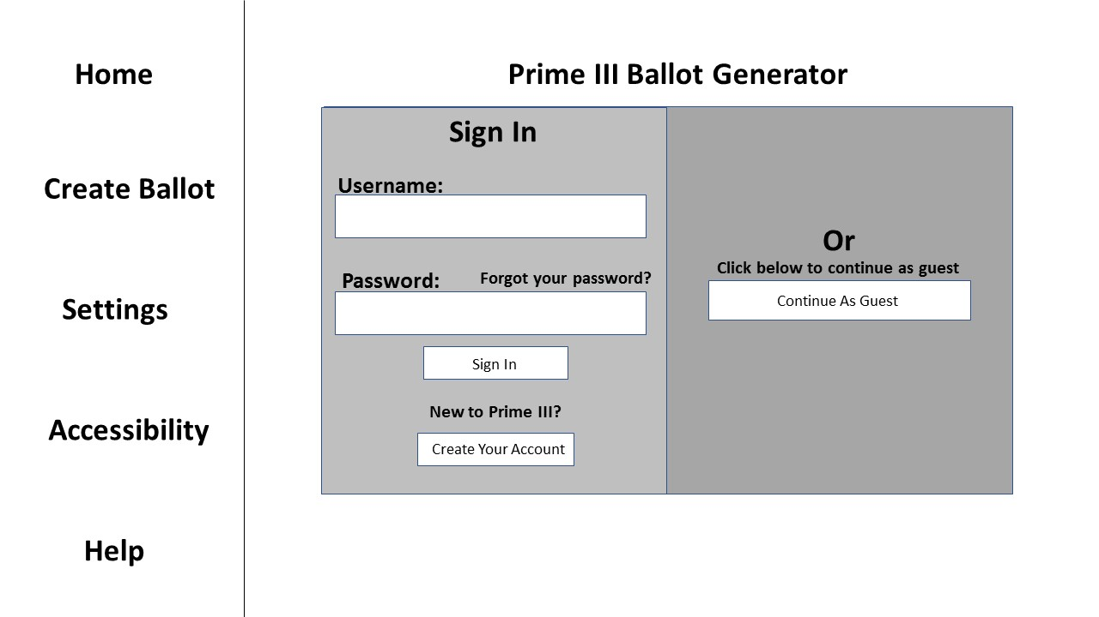
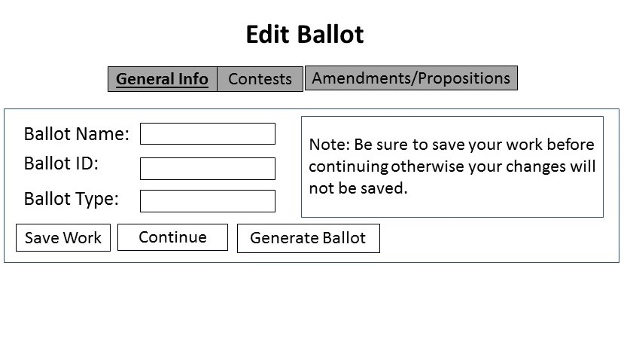
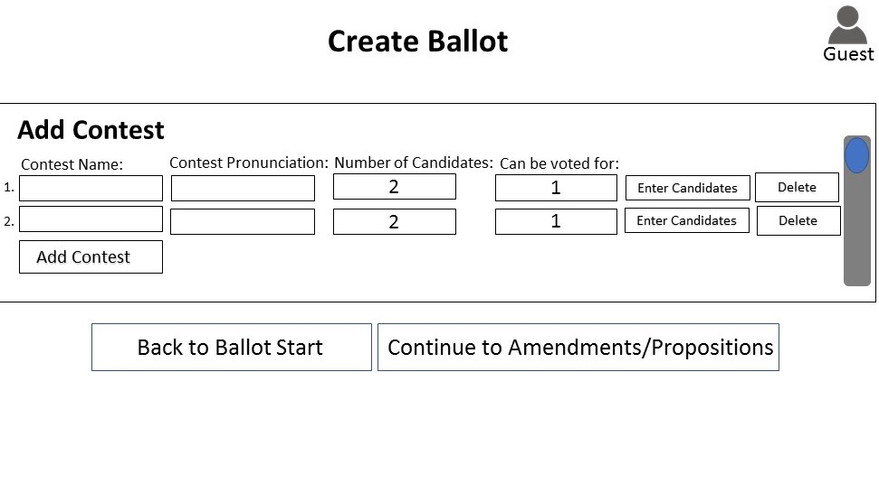
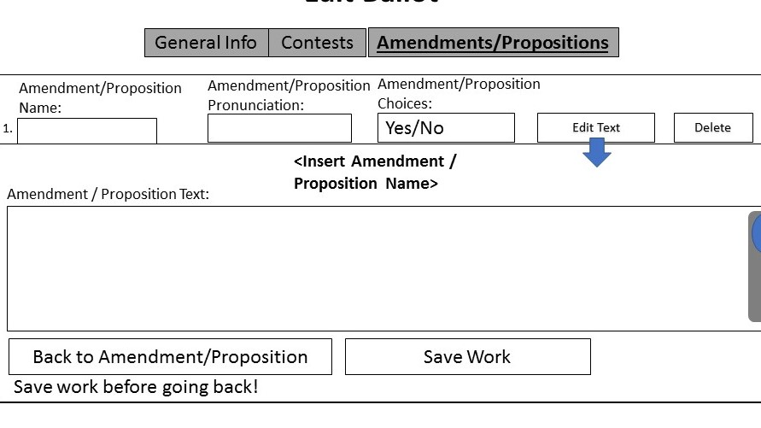
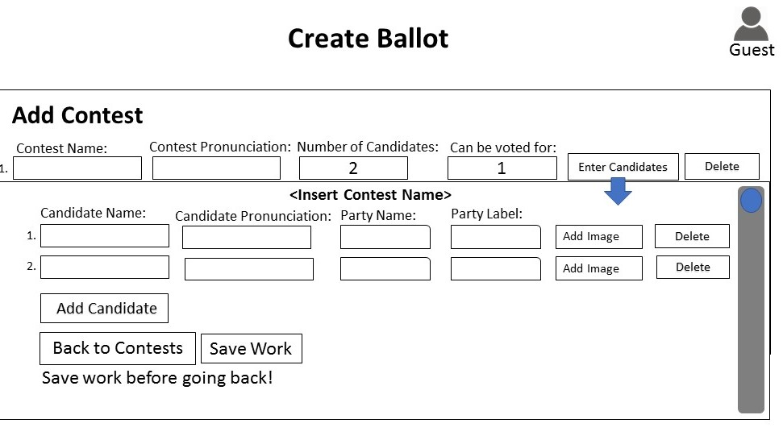
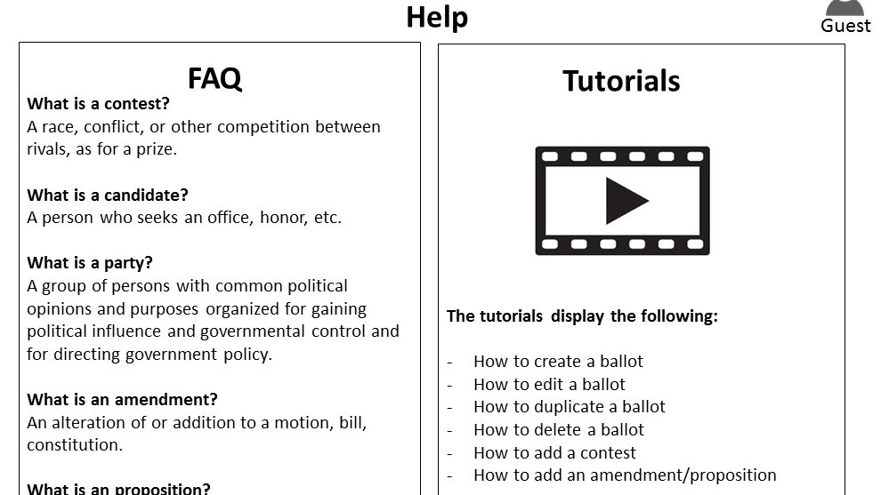
[PBC] Project Ballot Creator
Koran Wright
Sophomore
Mississippi Valley State University
Koran.Wright@mvsu.edu
Simone Smarr
University of Florida
Dr. Juan E. Gilbert
University of Florida
Introduction
Wire Frames
Project Ballot Creator is designed so people can create ballots for voting.
How could someone create a ballot with no problem, quick and easy?
What do a user want in a website? How would the user use the website.
Questions to ask during this ballot creator website process.
objectives
Gather information on what is needed to create a ballot.
What do users need to navigate through a website.
Make it easy as possible to get information from a user.
Create a detailed prototype of a ballot creator website and test what users do.
Better improve the design for users.
Have a design most users would like.
Pop up
Features
Easy navigation through ballot
Enter information with ease.
Can save work at anytime
Have help whenever needed.
Combined Idea
Data Collected
After first wire frame, I collected data.
Most users like color and the color chosen.
Navigation is a key factor
Most users need guidance when creating ballot.
conclusions
Pop up
From the data I collected during this summer, creating a ballot creator website takes a lot of designing and feedback. There is always room for editing and changing ideas. The more feedback I got from users, the better my design was. It open me to more ideas and how my website should be. It was nice to see my ideas in the final website design.

