Slide 1
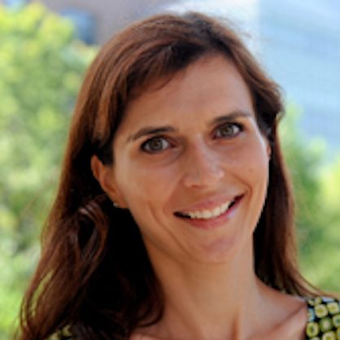
Hello!
I’m Olivia Smith
Sarah Korkes, Dr. Battestilli

Slide 2
Writing effective questions for Automated Grading using Bloom’s Taxonomy
Perception

Slide 3
The Issue:
Intro CS courses are growing rapidly among majors and non-majors
Non-major intro courses increased 55% from 2005 to 2015 (CRA)
Autograders are crucial in supporting large classes
Students frustrated by autograded questions

Slide 4
Related Work
Meta-Study found student perception was unclear (Pettit)
12 papers, 8 positive, 4 negative
9 were 10+ years old
Likes: Instant feedback, self-paced, multiple attempts (Benotti, Selby)
Dislikes: Precision required from code, grading w/out people (Pettit)

Slide 5
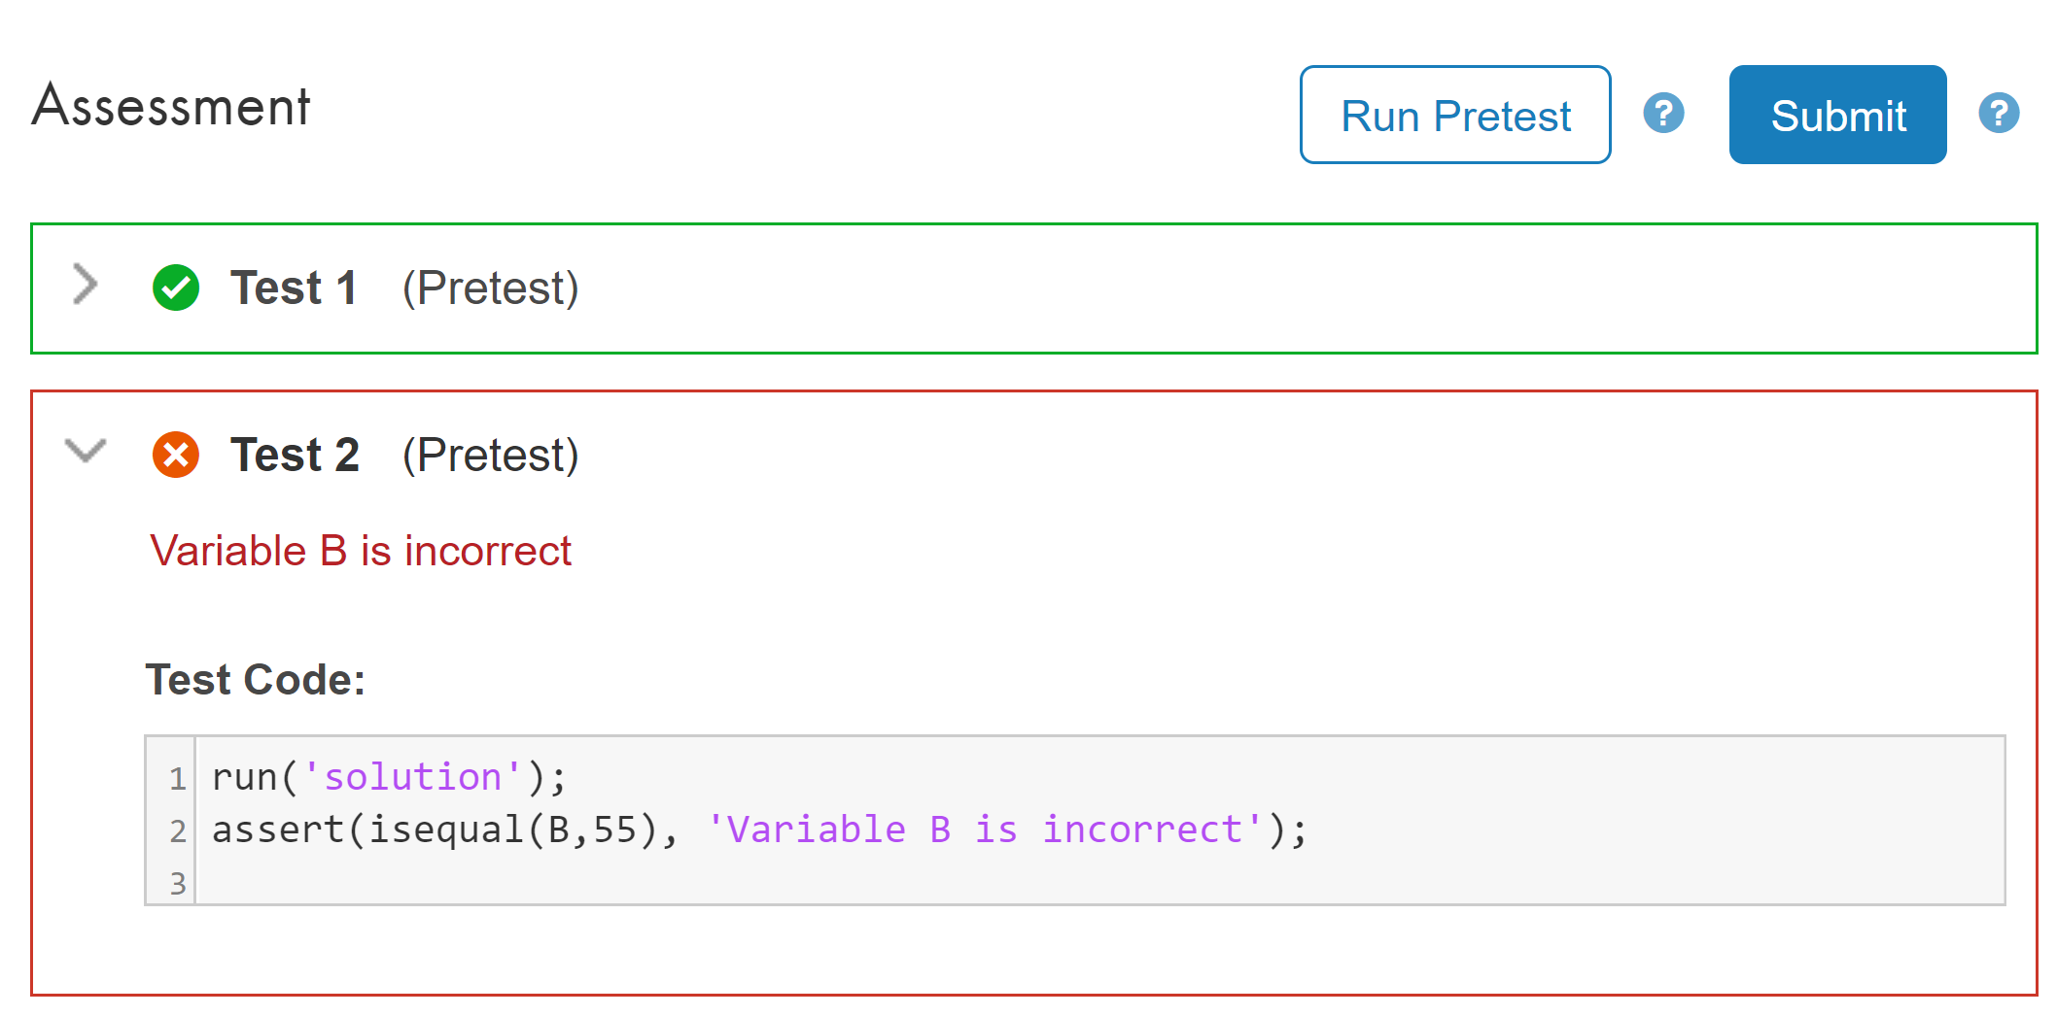
How can we improve the student experience?

Slide 6
Purpose
Our study seeks to better the student learning experience by scaling the complexity of autograded questions

Slide 7
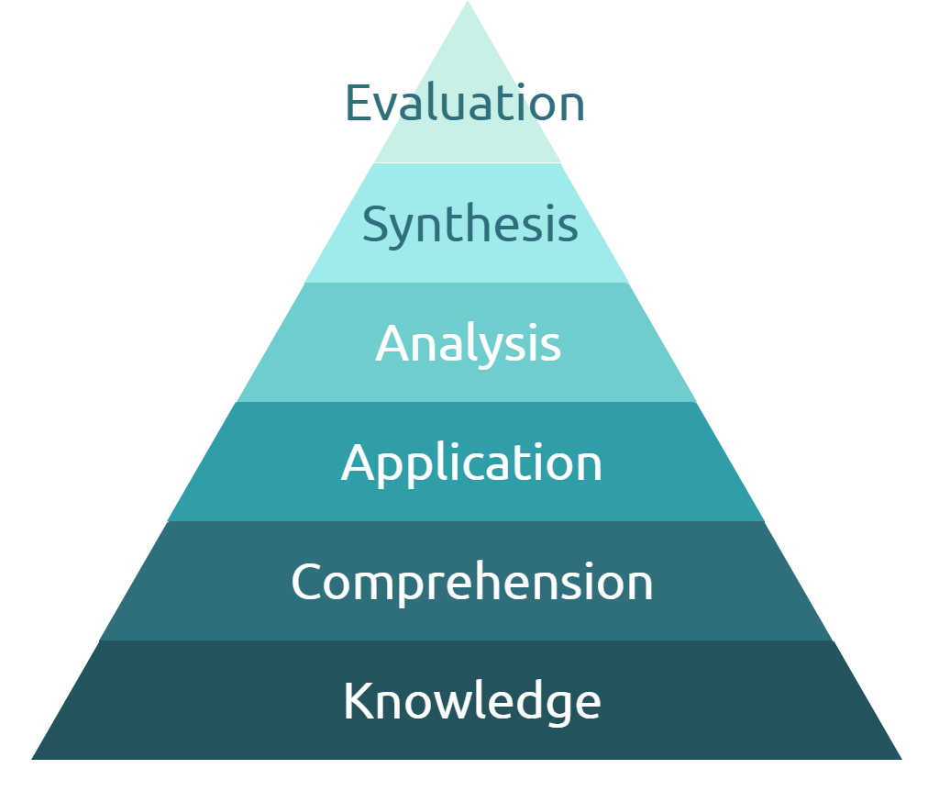
Method
Participants: novice, non-CS majoring programmers enrolled in an Intro to MATLAB course
Questions written according to Bloom’s Taxonomy
Experimental’s questions increase in difficulty
Control’s questions unordered

Slide 8
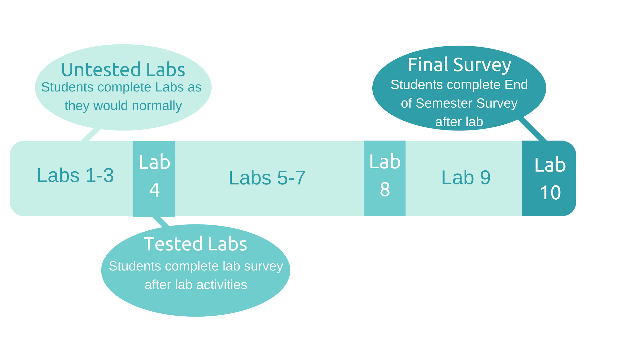
Lab Surveys:
Self efficacy
Questions
Cody Coursework
Final Survey:
Cody Coursework
Questions
Self Efficacy
Notes:
Here’s a flowchart of the programming course; we aren’t manipulating anything in the first three weeks of lab, but lab 4 is where the magic happens. The experimental group receives the scaled questions and control receives the unordered sets. After they complete these problems, both groups take an end of lab survey (click through lab survey bullets)
The survey emphasizes self efficacy the most, followed by the student’s perception of the actual questions, and finally asks a brief question about Cody Coursework.
This happens again at lab 8.
After the completion of the final lab, lab 10, st

Slide 9
Expected Results
Student learning experience will improve with the scaled questions
Increased self efficacy in programming abilities
Positive opinion of autograders and CS
Student retention in engineering programs
Intro programming professors may adopt our question framework

Slide 10
Further Work
Data will be collected Fall 2018 & analyzed Spring 2019

Slide 11
References
Benotti, L., Aloi, F., Bulgarelli, F., & Gomez, M. J. (2018). The Effect of a Web-based Coding Tool with Automatic Feedback on Students Performance and Perceptions. Proceedings of the 49th ACM Technical Symposium on Computer Science Education - SIGCSE 18. doi:10.1145/3159450.3159579
Computing Research Association (2017). Generation CS: Computer Science Undergraduate Enrollments Surge Since 2006. http://cra.org/data/Generation-CS/
Pettit, R., Homer, J., Holcomb, K., Simone, N., & Mengel, S. (n.d.). Are Automated Assessment Tools Helpful in Programming Courses? 2015 ASEE Annual Conference and Exposition Proceedings. doi:10.18260/p.23569
Selby, C. C. (2015). Relationships. Proceedings of the Workshop in Primary and Secondary Computing Education on ZZZ - WiPSCE 15. doi:10.1145/2818314.2818315

Slide 12
Thanks!
Any questions?

