Slide 1
Collective Privacy Policies

Slide 2
The three scenarios
Censor Bar
Keyword Tagging
Group Agreement

Slide 3
Minimal Collaboration
Censor Bar Feature

Slide 4
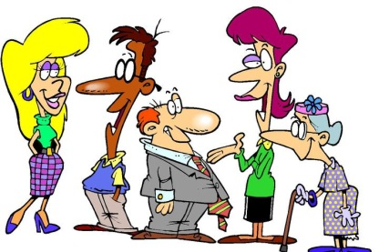
Censor Bar Feature
A photo of friends
Mary
Mary uploads a photo to a social networking website.

Slide 5
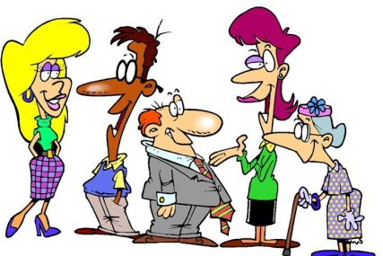
Censor Bar Feature cont.
Mary’s friends
The photo of friends
Mary
Mary tags her friends in the photo.

Slide 6
Censor Bar Feature cont.
!
The photo Jake was recently tagged in.
Jake
Jake is notified that he was tagged in the photo.

Slide 7
Censor Bar Feature cont.
I wish my co-workers couldn’t see me in this picture.
The photo Jake was tagged in.
Jake views the photo and doesn’t like the way he appears in the photo.
Jake

Slide 8
Censor Bar Feature cont.
People in my “co-worker” list can’t see me in this picture now.
The photo Jake was tagged in.
Jake can choose to censor out his tagged image in the photo, and decide who in his friends list can see the censor bar.
For those who see the censor, the photo will then no longer be displayed along with other photos Jake was tagged in.
Jake

Slide 9
Medium Collaboration
Keyword Tagging

Slide 10
Keyword Tagging
A photo of friends
Alex
Alex uploads a photo to a social networking website.

Slide 11
Keyword Tagging cont.
Alex’s friends
The photo of friends
Alex
Alex tags his friends in the photo.

Slide 12
Keyword Tagging cont.
This is a photo of my co-workers, so I am going to tag this photo with the keyword “work.”
Keyword List examples:
Animals
Artistic
Athletic
Cute
Embarrassing
Fashion
Funny
Graduation
Holiday
Nature
Lounging
Party
Vacation
Work
Photo tagged with keyword “work” now.
Alex
Alex then tags the photo with keywords that describe the contents of the photo.

Slide 13
Keyword Tagging cont.
Keyword List examples:
Animals
Artistic
Athletic
Cute
Embarrassing
Fashion
Funny
Graduation
Holiday
Nature
Lounging
Party
Vacation
Work
Hannah’s custom made friends lists:
Family list cannot view photos tagged with keywords:
Party
Work
Friends list cannot view photos tagged with keywords:
Embarrassing
Work
Close Friends list cannot view photos tagged with keywords:
Lounging
Hannah – tagged in the photo uploaded by Alex
Users create lists of friends based on who they want to be able to view certain types of photos, this is built around a set list of predefined keywords

Slide 14
Keyword Tagging cont.
Visibility approved for those in the Close Friends list.
Hannah’s Close Friends list
X
Hannah’s Family list
Visibility denied for those in the Family list.
Hannah
Recall that Alex tagged the photo with the keyword “work.”
Since Hannah does not want family members to see photos of her at work, she had made photos tagged with the keyword “work” not visible by those in her Family list.

Slide 15
Maximum Collaboration
Group Agreement

Slide 16
Group Agreement
A photo of friends
Liz
Liz uploads a photo to a social networking website.

Slide 17
Group Agreement cont.
Mary’s friends
The photo of friends
Liz
Liz tags her friends in the photo.

Slide 18
Group Agreement cont.
!
The photo
Jake
!
!
Alex
!
Hannah
Kathy
Everyone tagged is notified that he/she was tagged in the photo.

Slide 19
Group Agreement cont.
Negotiation area
After Liz uploads the photo and her friends are tagged, the photo is put into a temporary negotiation area where no one else can view the photo except those who were tagged in it and the uploader, Liz, in this case.

Slide 20
Group Agreement cont.
Negotiation area
Everyone involved suggests who they want to be able to see the photo, and they can choose people from the other tagged user’s friends lists who they do not want to see the photo.

Slide 21
Group Agreement cont.
I don’t see why not.
Is my family allowed to see this picture?
Go for it.
Not a problem.
Sure.
Before the photo is truly uploaded to Facebook, everyone involved in the negotiation area must agree to the terms set by the group. If not, then the photo is not uploaded.

Slide 22
End
Please copy this answer number into the answer box for question 1, then continue on with the rest of the survey.
Answer: 4626

